Slide 1
COVID-19 Digital Guideline Working Group Best Practice Collaboratory
Continually delivering and discovering the next best practice
TO Provide
Best Care Everywhere

Slide 2
COVID-19 Digital Guideline Working Group Using The Agile CPG Development Approach
Continually delivering and discovering the next best practice

Slide 3
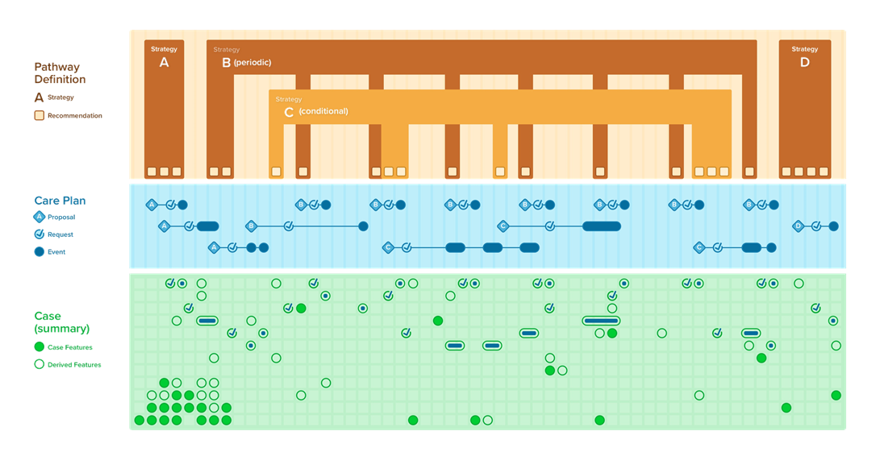
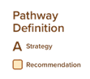
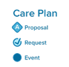
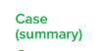
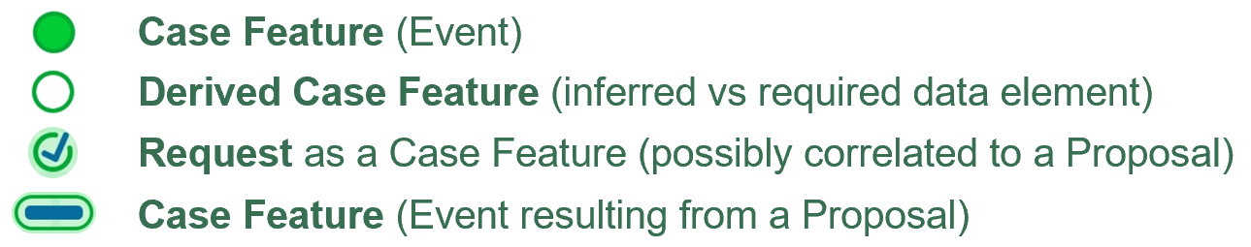
Clinical Practice Guidelines (CPG-on-FHIR)
(Profiled) FHIR Plan Definition(s) + CQL
http://build.fhir.org/ig/HL7/cqf-recommendations/index.html
Notes:
The CPG Pathway Definition that contains all the CPG-specific knowledge content and assets including the CPGRecommendations (and CPGStrategies); The CPGCase that scopes all the required data elements (CPGFeatures) including many of the patient-specific inferences thereon (inferred CPGCaseFeatures); and the CPGCarePlan that includes the patient-specific recommendations (CPGProposals) and any resulting or relevant orders, prescriptions, scheduling (CPGRequests) and the data elements representing the events that fulfill these requests (a subset of the CPGCaseFeatures)
The top third illustrates the conceptualization of the CPGPlan consisting of the CPGPathway Definition, CPGStrategyDefinition, and CPGRecommendation Definition. The bottom third illustrates the CPGCase consisting of all the patient descriptors, including exposures, physiological and pathophysiological assessments and descriptions, clinical presentation and progression, diagnostic evaluations and physical findings, past and current diagnoses and procedures, related risk and severity scores, and family history and genetic profile as CPGCaseFeatures. The middle third illustrates the CPGCarePlan with its CPGProposals and resulting or related Requests and Events.

Slide 4
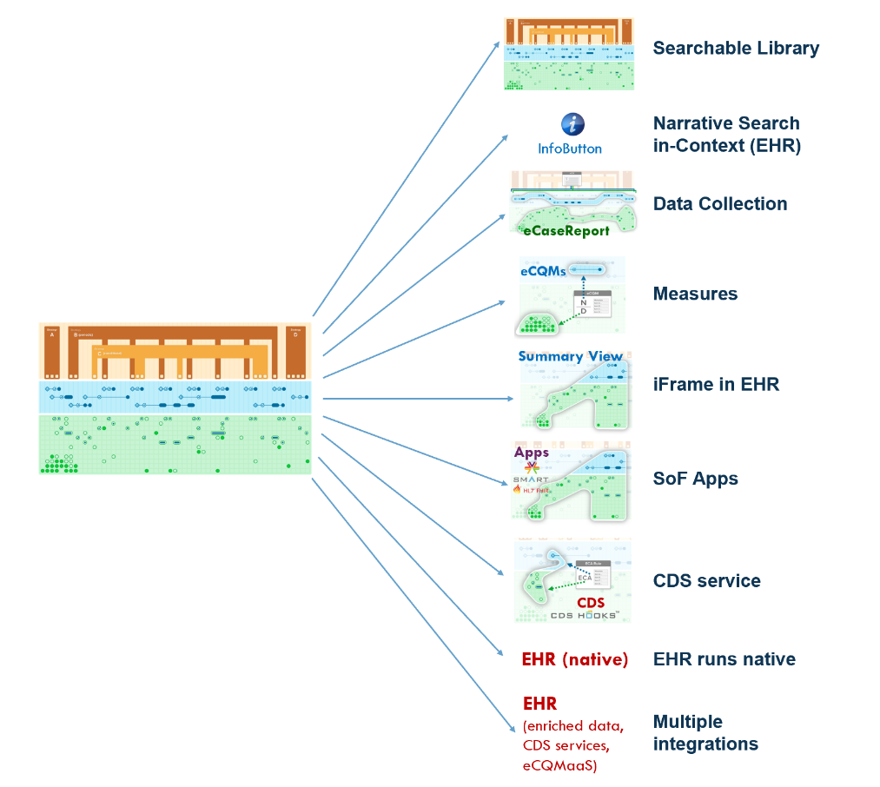
One Translation
Many Derivatives & Ways to Implement It

Slide 5
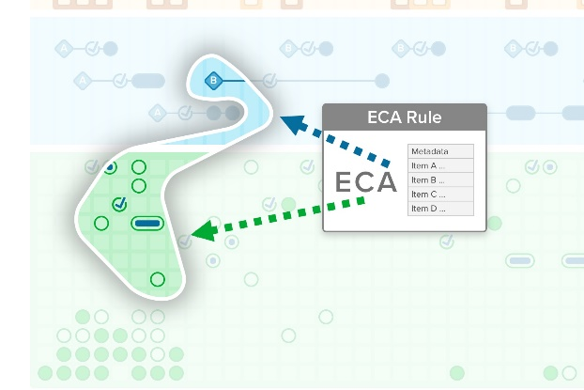

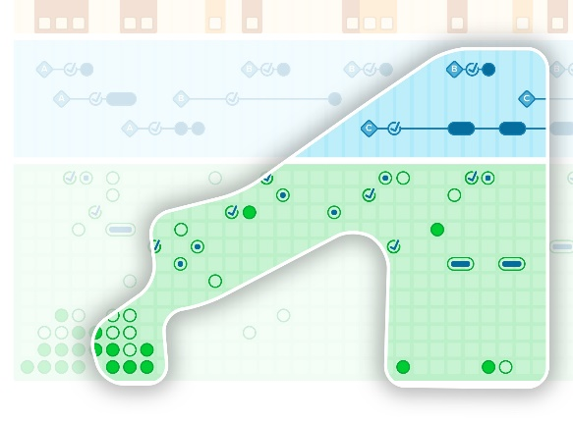
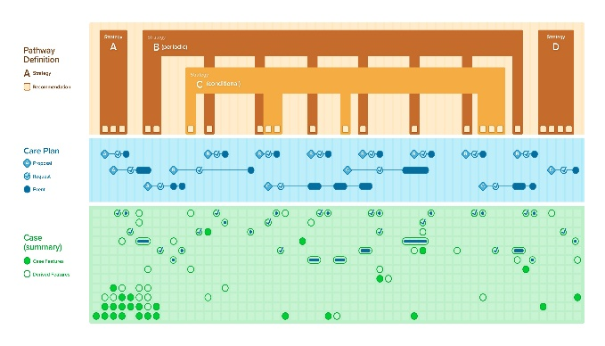



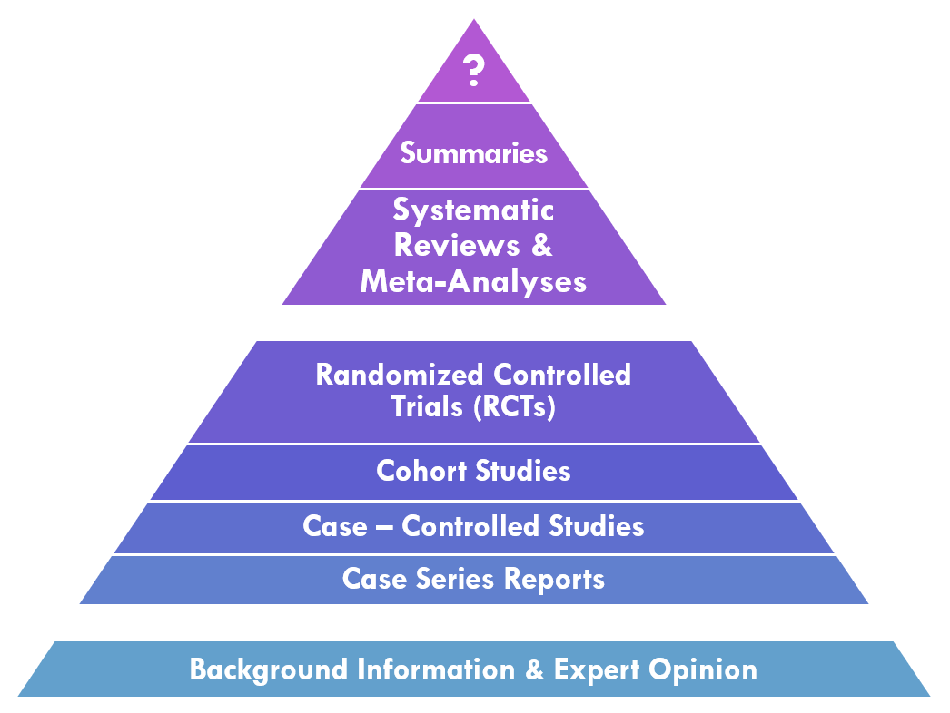
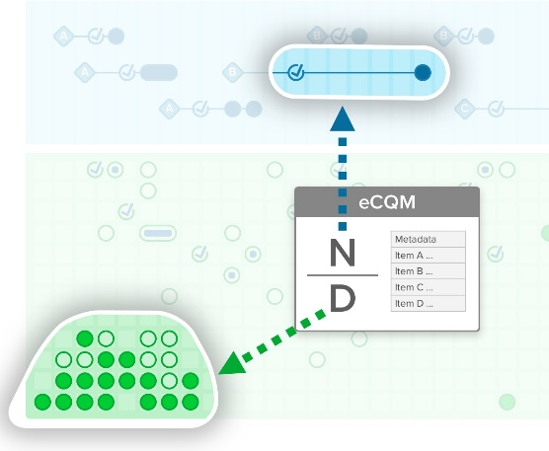
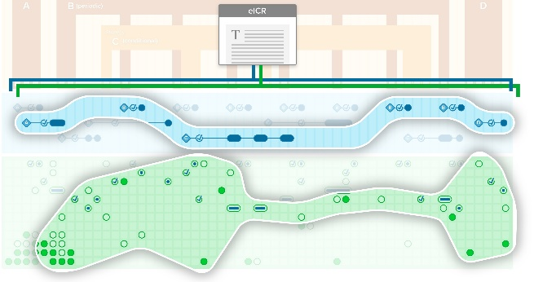
Guideline Development Process
Feedback, Iteration
Practice Governance
Knowledge Engineering Lifecycle
Local Informatics &
EHR Build
CDS
Feedback, Iteration
InfoButton
Apps
CPG-on-FHIR
KNOWLEDGE
ACTION
EBM-on-FHIR
EHR
INFORMATION
DATA
RESEARCH
eCQMs
Research-on-FHIR
eCaseReport
eCR-on-FHIR
CQM-on-FHIR
Notes:
Knowledge-to-Action-to-Data-to-Evidence Lifecycle

Slide 6
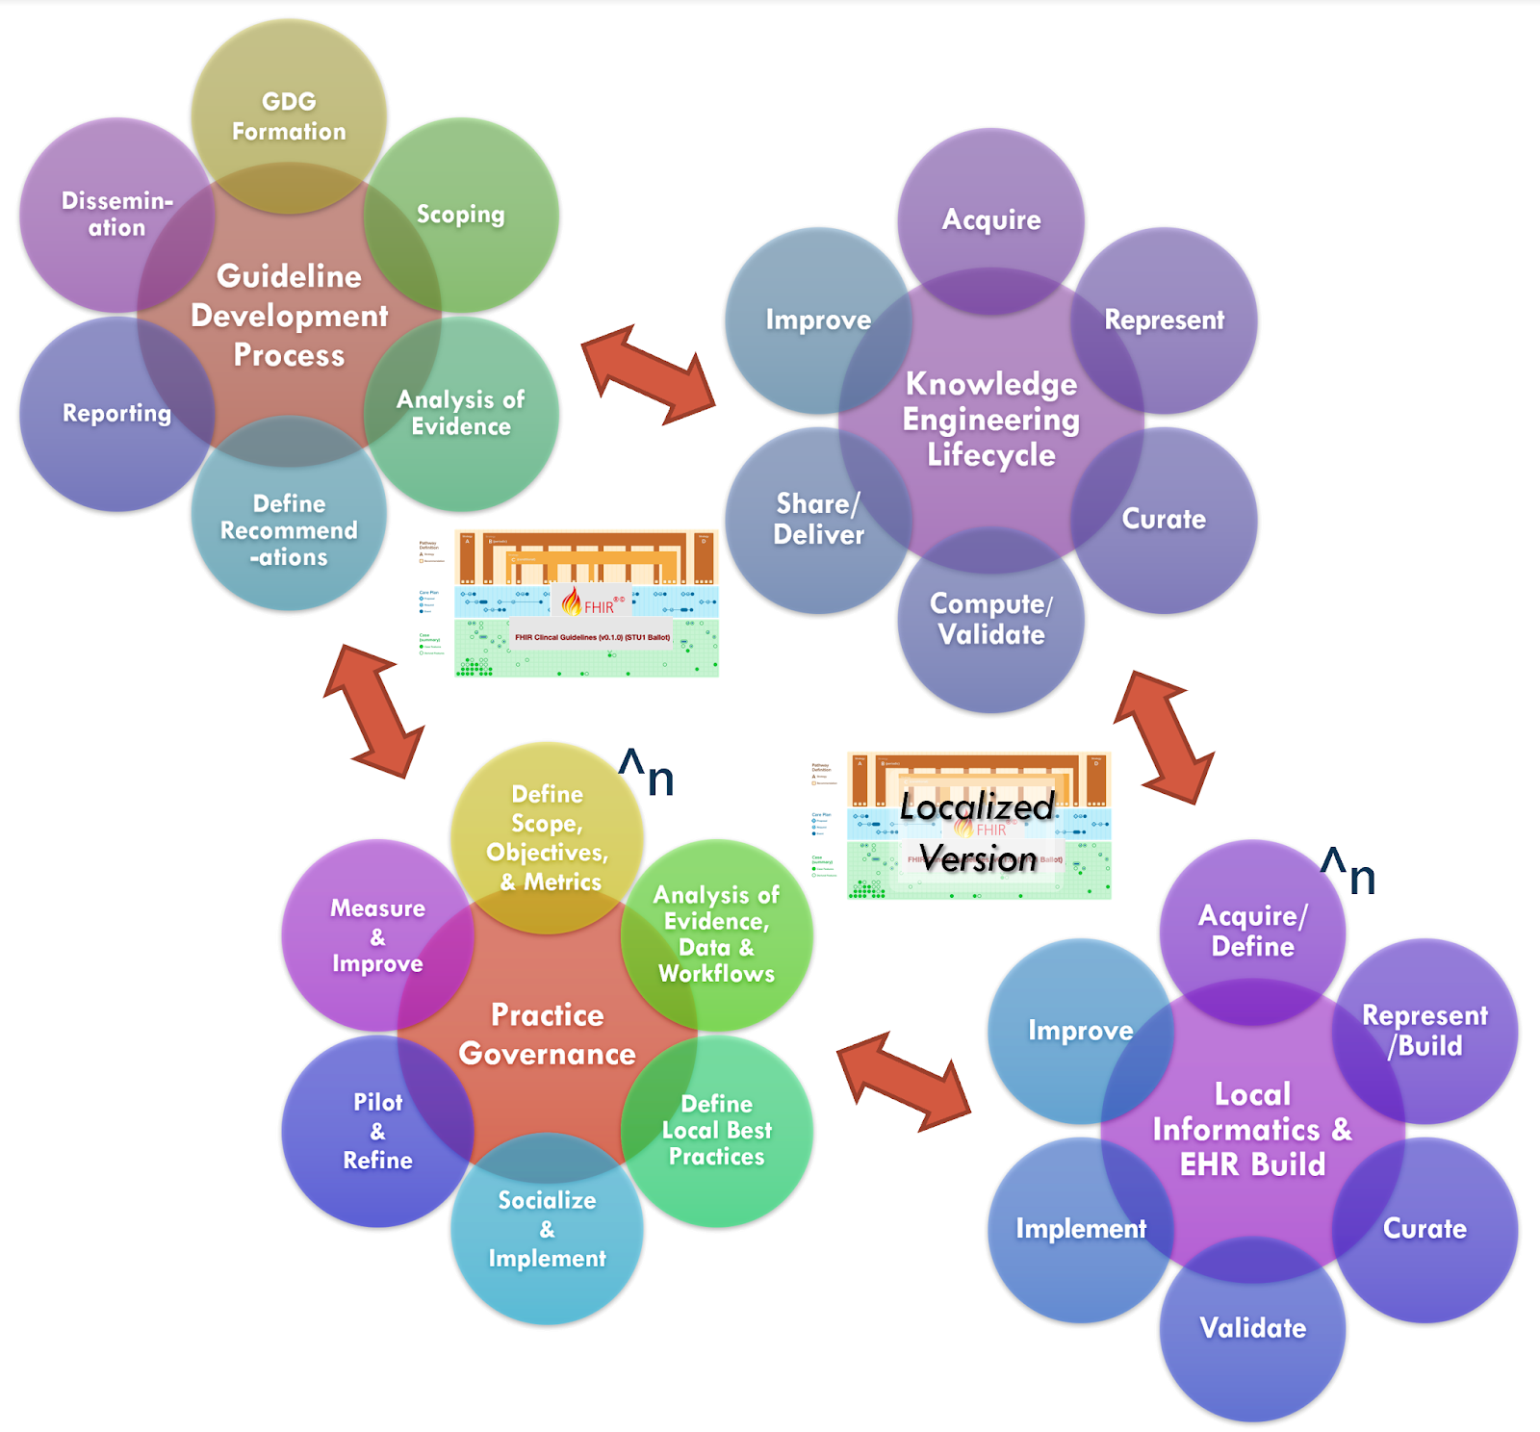
Integration & Collaboration of Guideline Development Process & CPG Knowledge Engineering Lifecycle Processes, together with Local Practice Governance & Informatics/ EHR Build

Slide 7
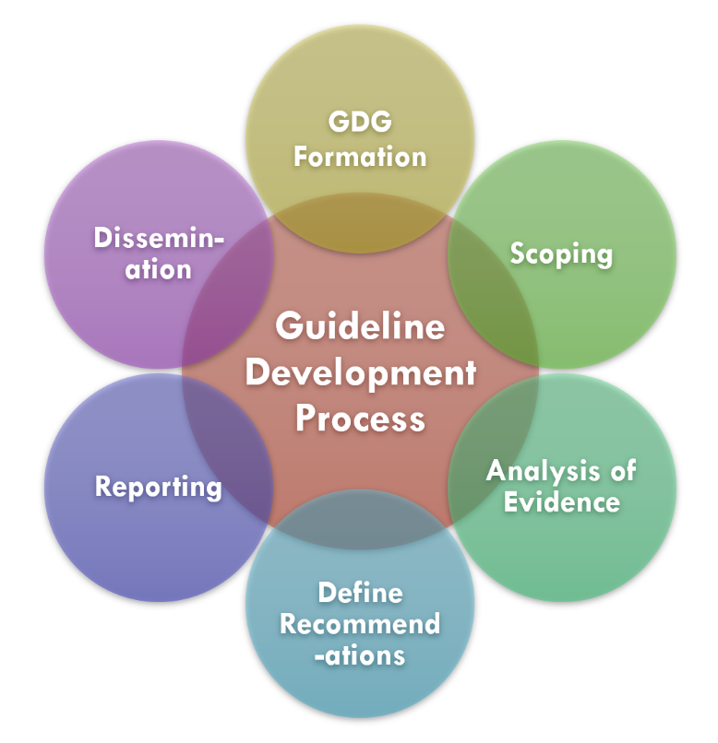
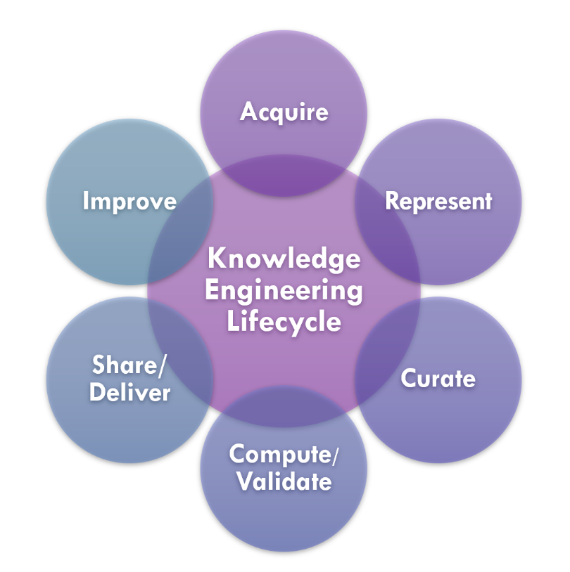






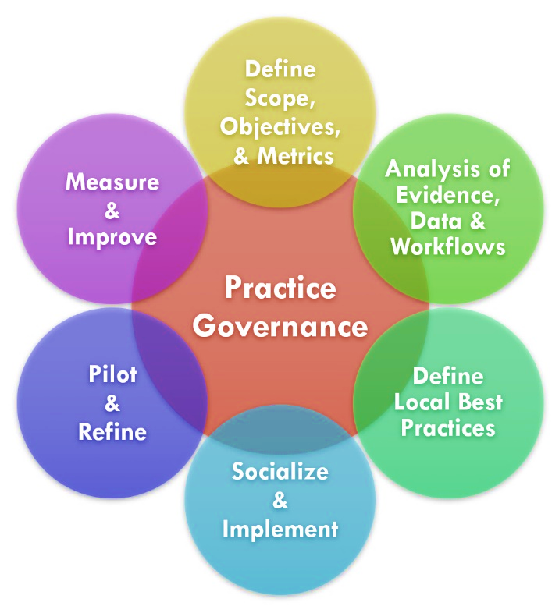
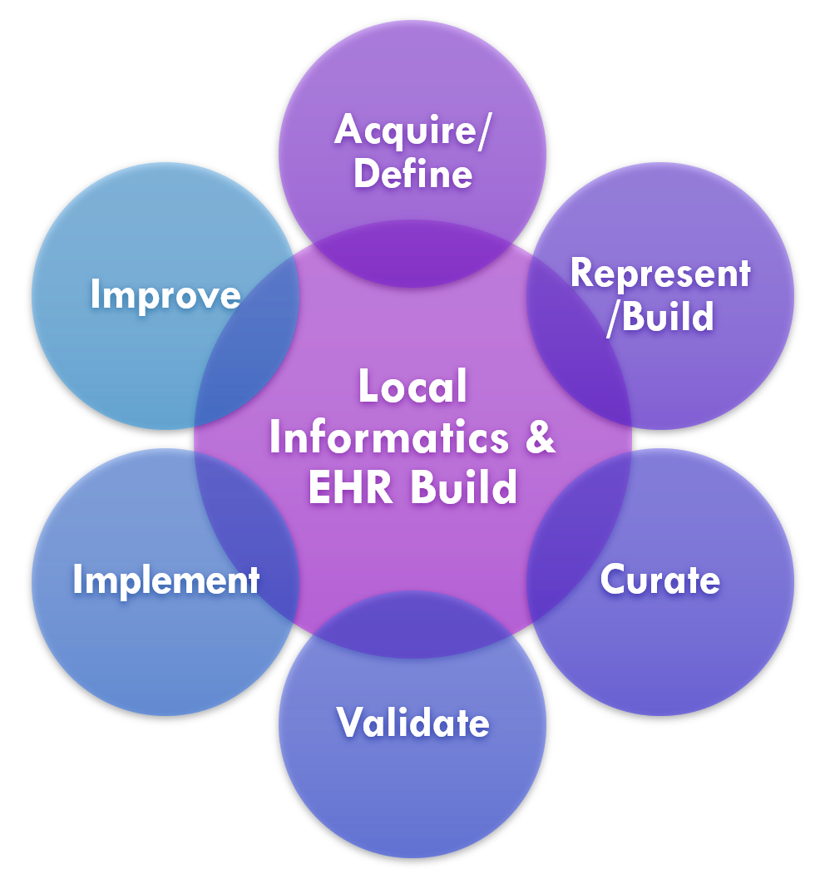
Feedback Loop & Iteration
Feedback & Iteration during Development
^n
Localized
Version
^n
Potential for
Feedforward or
Fast Track
InfoButton
xx
eCQMs
E
H
R
Apps
eCaseReport
CDS

Slide 8
New Disease Necessitates Rapid Dissemination (and Discovery) of the Next Best Practice… CPG-IG and Agile Approach to CPG
C19 Digital Guideline Working Group
Details in Appendix 2

Slide 9
C19 Digital Guidelines Org Structure
Program Management Group
Content Team
Agile CPG Team 1
Agile CPG Team 2
Agile CPG Team 3
Agile CPG Team 4
Agile CPG Team 5
...
Use Case 1
Use Case 2
Use Case 3
Use Case 4
Use Case 5
Knowledge Engineering and Terminology Team
Knowledge Architecture & Standards
Knowledge Validation Team
Delivery and Dissemination Team
Implementation Team and Local Site(s)

Slide 10
C19 High Level Approach
Evaluation
Validation
Knowledge Repository
Content
L1
Feed back
L2
L4
L3
Agile CPG
Knowledge Engineering
Delivery and Dissemination
Implementation
Agile CPG
Agile CPG
Terminologies
Knowledge Architecture and Standards
Notes:
Potentially leverage HL7 FHIR CPG-IG graphics conveying similar message. May be advantageous to have this document align with the IG

Slide 11

Agile KE Overview
Cross-functional, Integrated Team
Agile CPG Team, Concurrent L1/2/3 Development
“Chunking” (composite artifacts)
Progression of incremental, focused parts
Iteration, rapid-cycle feedback
Together with incremental parts
Test-driven Knowledge Engineering
Specify by Example -> Incremental Testing -> Validation
Leverage Knowledge Base
‘Intelligent’ Knowledge Content Management System
Details of Agile Approach to CPG in Appendix 2

Slide 12
Knowledge Representation “Levels”
Knowledge Level | Description | Example
L1 | Narrative | Guideline for a specific disease that is written in the format of a peer-reviewed journal article
L2 | Semi-structured | Formal flow diagrams, decision trees, or other similar formats that describes recommendations for implementation
L3 | Structured | Standards-compliant specification encoding logic with data model(s), terminology/code sets, value sets that is ready to be implemented
L4 | Executable | CDS implemented and used in a local execution environment (e.g., CDS that is live in an electronic health record (EHR) production system) or available via web services
**Note the Levels do not describe a process or required flow, though processes, methods, and tools do often support translation between Levels. Also, the levels of knowledge representation are a continuum, with discrete categories introduced in the methodology to help inform discussions and communicate the concepts involved. L1 targets Domain SME’s, L4 is run-time software, L2 should be readable by humans- Domain SME’s and Technical Knowledge Engineers who must use the L2 to construct faithful computable expressions (L3). L2/L3 *may* also exist as part of an Editor.

Slide 13
Levels of Representation Reconceptualized
Framework for Describing Nature of Representation
Tradition Knowledge Engineering Approach:
Process Steps that mimicked Progression of Levels-
L2 only on Final L1
L3 only on completion of L2
Agile KE:
Concurrent, iterative, integrated, and cross-functional
Different Expertise work on Different Levels concurrently
Knowledge Increments across Levels
Waterfall
GDP, KE, CDS, &
Implementation
L1
L2
L3
L4
L1
- Shared Tooling
- Shared Information
- Incremental
- Concurrent Development
- Iterative, Rapid Feedback
- Test-Driven
- Reuse Content
Agile
Integrated
Cross-functional
CPG-IG Approach
L2
L3
L4

Slide 14


L1
L2
L3
Knowledge Engineering Lifecycle
Acquire
Represent
Improve
Share/ Deliver
Compute/ Validate
Curate
L1
L4
Agile Translation
with Chunking
L2
*translation
*translation
L3
(within and across Tiers and Formalisms)
CPG IG
Use of Real-World Data for Design, Specification, Development, & one-time Validation
(exact path dependent on Methods of Implementation and mechanisms of Delivery)
Notes:
- Concurrent (vs sequential) Effort - Collaboration & Participation across Functional Tasks - Frequent Direct Communication - Translation of “Chunks” - No requirement to follow 1-2-3-4

Slide 15
Guideline Development Lifecycle
Practice Governance
Clinical Informatics
Local Informatics or Implementer
/ EHR Build
RWE
Local
Pilot
Domain
2
Domain
3...
Domain
1
Info
button
Enablements
Infobutton
App
L1
L1
L1
eCR
L2
L2
L1
L3
L2
L3
L2
L3
L3
Content Governance
L1
L2
L3
FHIR R4 API /
CDS Hooks
Host 1
eCQM
L4 Implementation
L4
L1
L1
L1
L4
Evaluation/ Feedback
L2
L2
L1
L3
L2
L3
L2
Smart on FHIR
Host 2
L3
L3
ECA
L1
L2
L3
Evidence Synthesis/ Professional Societies
Definitional Resources
Host 3...
DEQM
Measure-as-a-Service
CQL Libraries
Data Model
Terminology + Value Sets
CPG
Terminology + Concept Maps
Clinical SME
Knowledge Engineering Lifecycle

Slide 16
Program
Management
Provide Vision & Strategy, Coordinate Team Efforts, Shared Lessons Learned, Remove Blockers, Nurture Ecosystem Partnerships
Per Prioritized CPG, though some assets will be reused across CPGs
Content
Identify Need & Opportunity
Prioritized CPG Topic Defined & Feasible
Agile CPG Team Formed
CPG L1, L2, L3 Initiated
CPG L1, L2, L3 Iterated
CPG L1, L2, L3 Finalized
Knowledge
Engineering
Common
Process & Tooling
Feasibility Assessment
L1->L2
Draft
L1, L2, L3
High Level v1
L1, L2, L3
‘Chunks’
Iterated
L1, L2, L3
Composites Iterated
L1, L2, L3
Finalized
Terminology
Core
Knowledge Engineering Effort
Common
Process & Tooling
Initial Data Requirements
Defined
Value Sets
Identified
Terminologies
Defined
Code
Mappings
Validation
Core
Delivery
Effort
Common Process, Tooling, & Data
Case
Examples
Test Cases
As Spec
Test Cases
Iterated
Expanded
Testing
Iterated
Expanded
Validation
Completed
Delivery
Core
Implementation
Effort
Common Capabilities, Approach & Tooling
Delivery Implications Identified
Adjust
Delivery
Approach
Test
Delivery
Mechanisms
Finalize
Delivery
Implementation
Engage & Communicate
Need
Share Best
Practices
Identify
Pilot Sites
Obtain RWD
IF Feasible
Planning
Engaging
Initiate
Limited Pilot
Knowledge
Architecture
Develop & Evolve Knowledge Architecture (Asset Definitions), Tooling Specifications,
Work with Standards Orgs, Enable Asset Re-usability and Shareability, Enable Knowledge Content Management

Slide 17
Waterfall
GDP, KE, CDS, &
Implementation
L1
L2
L3
L4
L1
- Shared Tooling
- Shared Information
- Incremental
- Concurrent Development
- Iterative, Rapid Feedback
- Test-Driven
- Reuse Content
Agile
Integrated
Cross-functional
CPG-IG Approach
L2
L3
L4
L1
L2
L3
L4

Slide 18

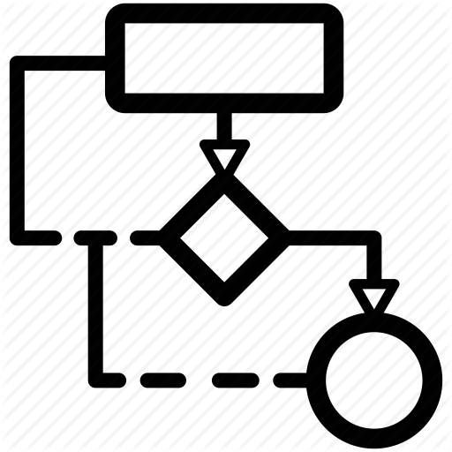

C19 Work Products
L1 – Narrative
L2 – Semi-Structured
L3 – Structured
L4 – Executable
T3 – Forms
Case Examples
User-interface Forms
Visualizations
Interaction Model
Flow Diagrams
Workflows
Decision Trees, Tables, and Flows
Concept Maps
Library (CQL)
ActivityDefinition
PlanDefinition
Inferred CaseFeatures
Application Services
Health Record Systems
Decision Services
Guideline narrative
Evidence Summaries
Tables & Figures
T2 – Logic
Glossaries
Domain Concepts
Indicator descriptions
Terminologies
Data Dictionary
CodeSystem
ValueSet
StructureDefinition
Data Requirements
Systems of Record
Registries and Exchanges
Data Services
T1 – Data
Notes:
L1 – Narrative content, so paper forms, guidelines, dictionaries, and other supportive documentation
L2 – Semi-structured, so personas, use cases, flow diagrams, decision trees, data dictionaries, and indicator descriptions
L3 – Structured, so Questionnaire, Library, ActivityDefinition, PlanDefinition, terminology resources, CQL logic, Measure
L4 – Running systems

Slide 19
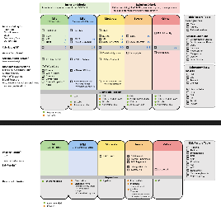
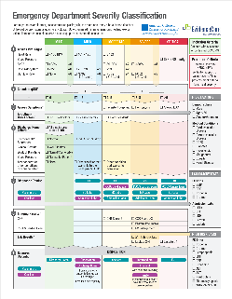
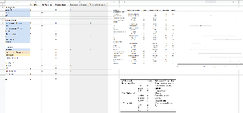
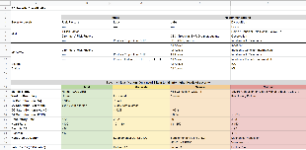
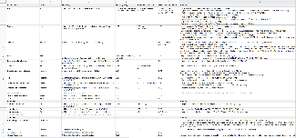
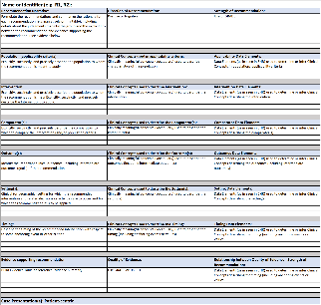
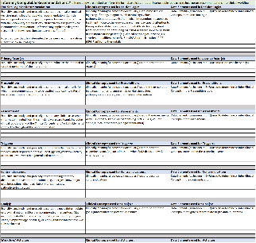
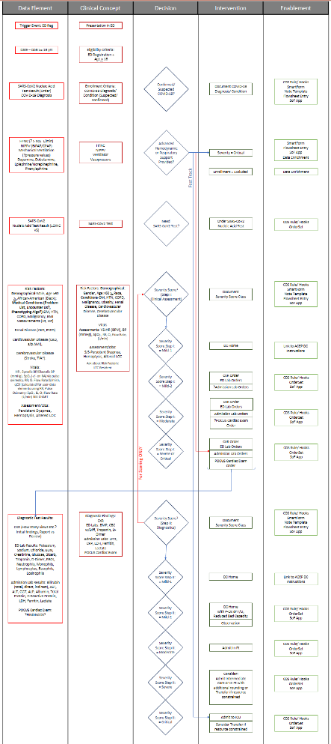
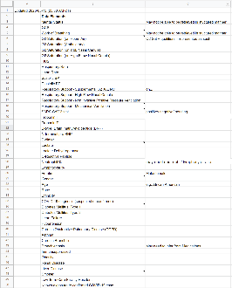
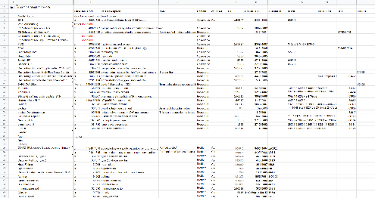
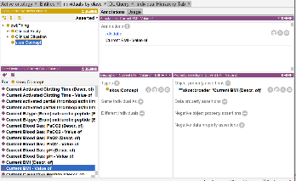
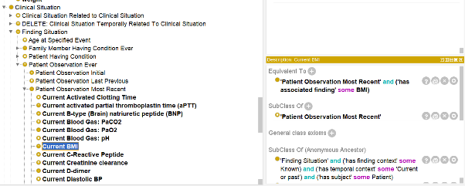
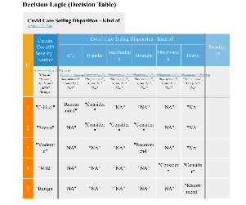
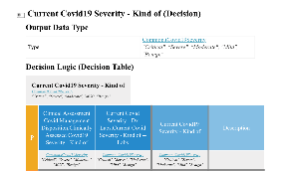
COVID-19 ED CPG Methodology- Part 1
Clinical
SME/ GDG
Scoping/
Evidence Review
Initial Draft of GL
Refinement of GL
Refinement of GL
Identification of Concepts
& Data Elements
SME KE
Describe Decision Flow using Separations of Concerns
Template to formalize Recommendations, state logic explicitly and identify Concepts & Data Elements used
Terminologist/
Ontologist
Formalization of Terminologies for Data Elements & Concepts
Technical KE
Modeling of Key Decision Logic
Define Clinical Ontology

Slide 20
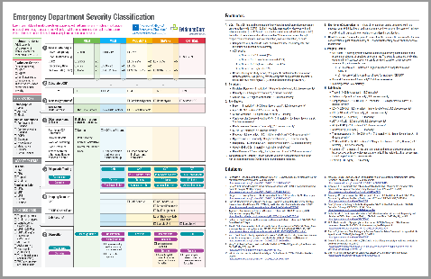
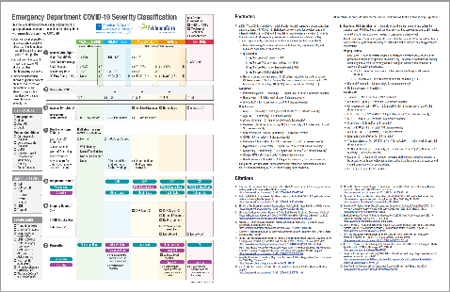
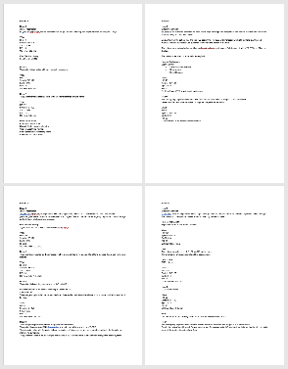
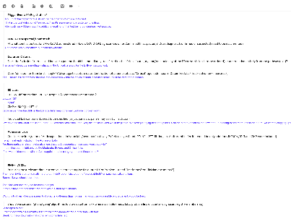
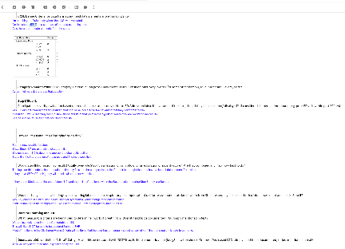
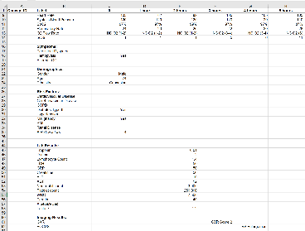
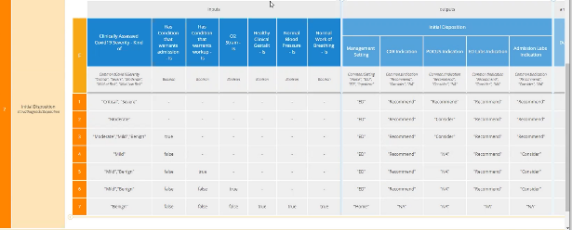
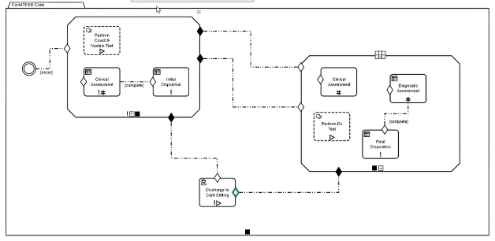
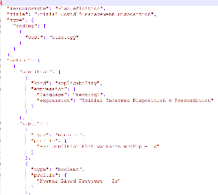
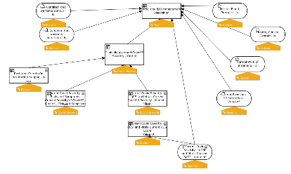
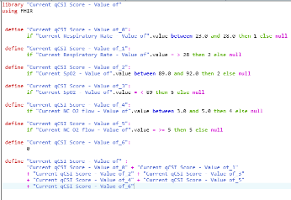
COVID-19 ED CPG Methodology- Part 2
Clinical
SME/ GDG
GL for Review
Final Narrative GL
SME KE
Resolution of Open Questions in making domain logic Explicit
Case Presentations and Example/ Test Data
Design Review(s); Testing & Validation
Terminologist/
Ontologist
Technical KE
Formal models of inferences & decisions
Formal models of full orchestration
Translation into CPG Artifact Specifications and Derivatives

Slide 21
L1 – Narrative
L2 – Semi-Structured
L3 – Structured
L4 – Executable
T3 – Forms
Case Examples
Paper Forms
User Stories
Personas
User-interface Forms
Visualizations
Interaction Model
Wire Frames
Flow Diagrams
Questionnaire (SDC)
Workflows
Decision Trees, Tables, and Flows
Triggers
Concept Maps
Library (CQL)
ActivityDefinition
PlanDefinition
Inferred CaseFeatures
Application Services
Health Record Systems
Decision Services
Guideline narrative
Evidence Summaries
Tables & Figures
T2 – Logic
Glossaries
Domain Concepts
Indicator descriptions
Terminologies
Data Dictionary
Indicators
CodeSystem
ValueSet
StructureDefinition
Data Requirements
Systems of Record
Registries and Exchanges
Data Services
T1 – Data
Notes:
L1 – Narrative content, so paper forms, guidelines, dictionaries, and other supportive documentation
L2 – Semi-structured, so personas, use cases, flow diagrams, decision trees, data dictionaries, and indicator descriptions
L3 – Structured, so Questionnaire, Library, ActivityDefinition, PlanDefinition, terminology resources, CQL logic, Measure
L4 – Running systems

Slide 22
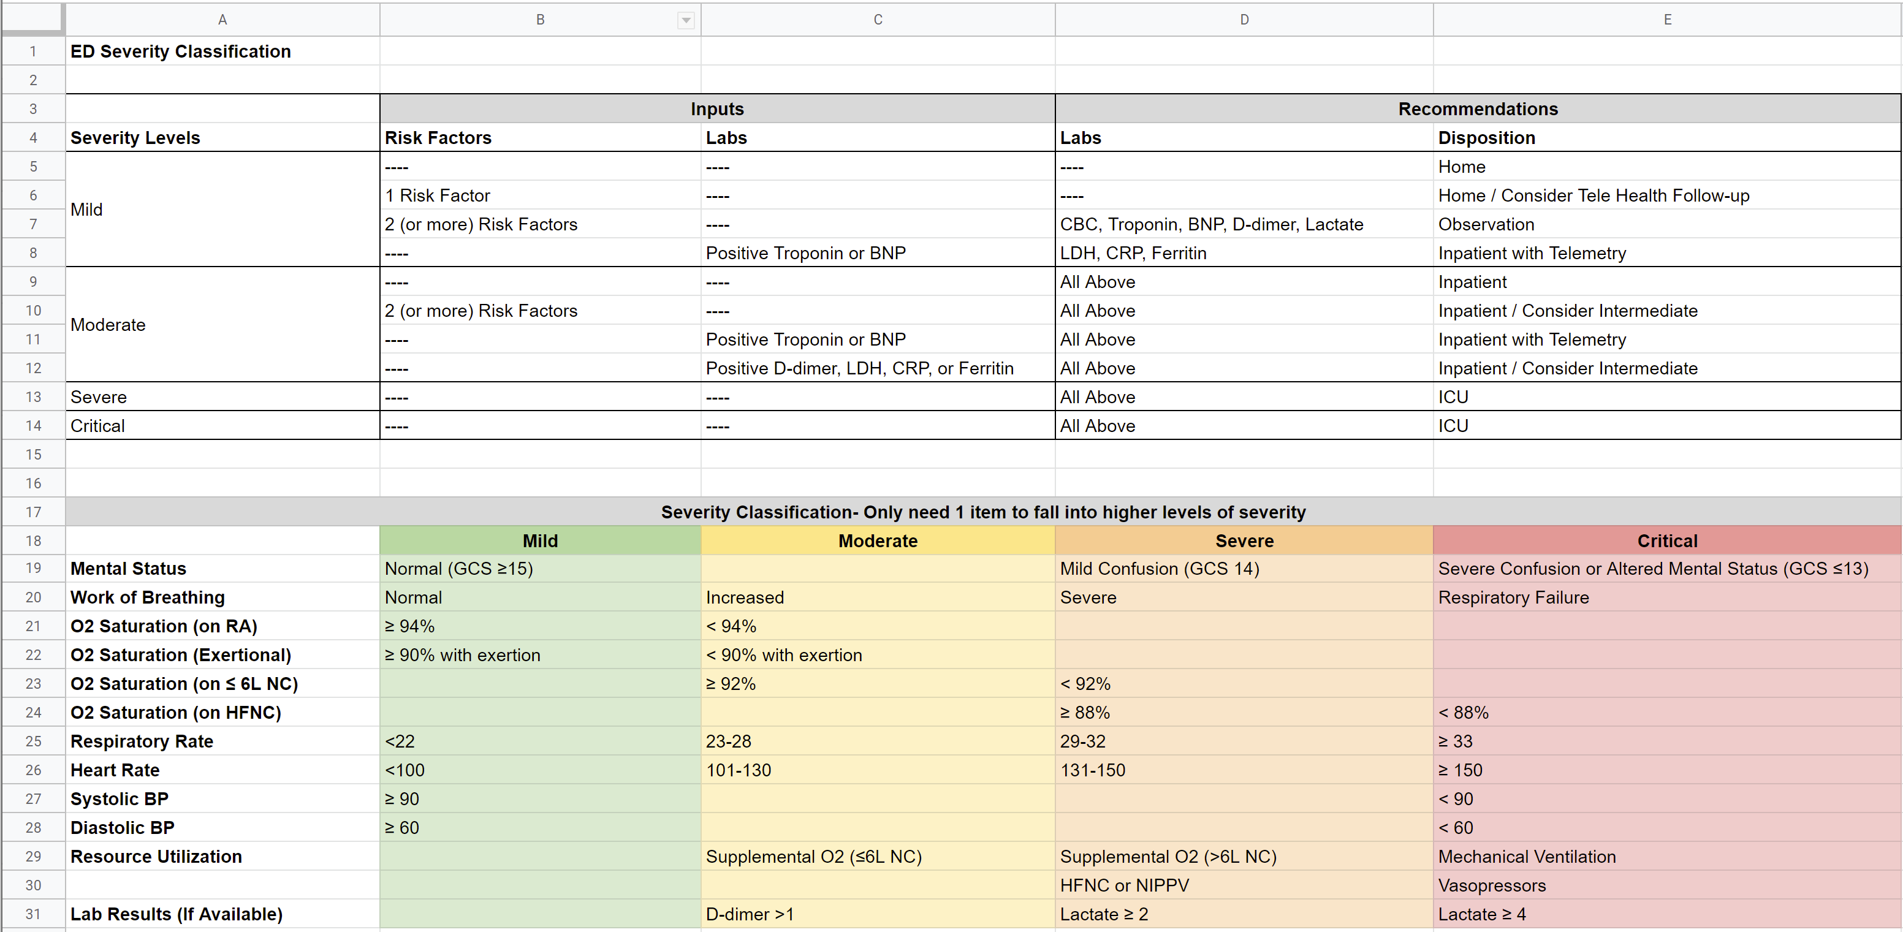
L1 – Narrative
L2 – Semi-Structured
L3 – Structured
L4 – Executable
T3 – Forms
Case Examples
Paper Forms
User Stories
Personas
User-interface Forms
Visualizations
Interaction Model
Wire Frames
Flow Diagrams
Questionnaire (SDC)
Workflows
Decision Trees, Tables, and Flows
Triggers
Concept Maps
Library (CQL)
ActivityDefinition
PlanDefinition
Inferred CaseFeatures
Application Services
Health Record Systems
Decision Services
Guideline narrative
Evidence Summaries
Tables & Figures
T2 – Logic
Glossaries
Domain Concepts
Indicator descriptions
Terminologies
Data Dictionary
Indicators
CodeSystem
ValueSet
StructureDefinition
Data Requirements
Systems of Record
Registries and Exchanges
Data Services
T1 – Data
Notes:
L1 – Narrative content, so paper forms, guidelines, dictionaries, and other supportive documentation
L2 – Semi-structured, so personas, use cases, flow diagrams, decision trees, data dictionaries, and indicator descriptions
L3 – Structured, so Questionnaire, Library, ActivityDefinition, PlanDefinition, terminology resources, CQL logic, Measure
L4 – Running systems

Slide 23
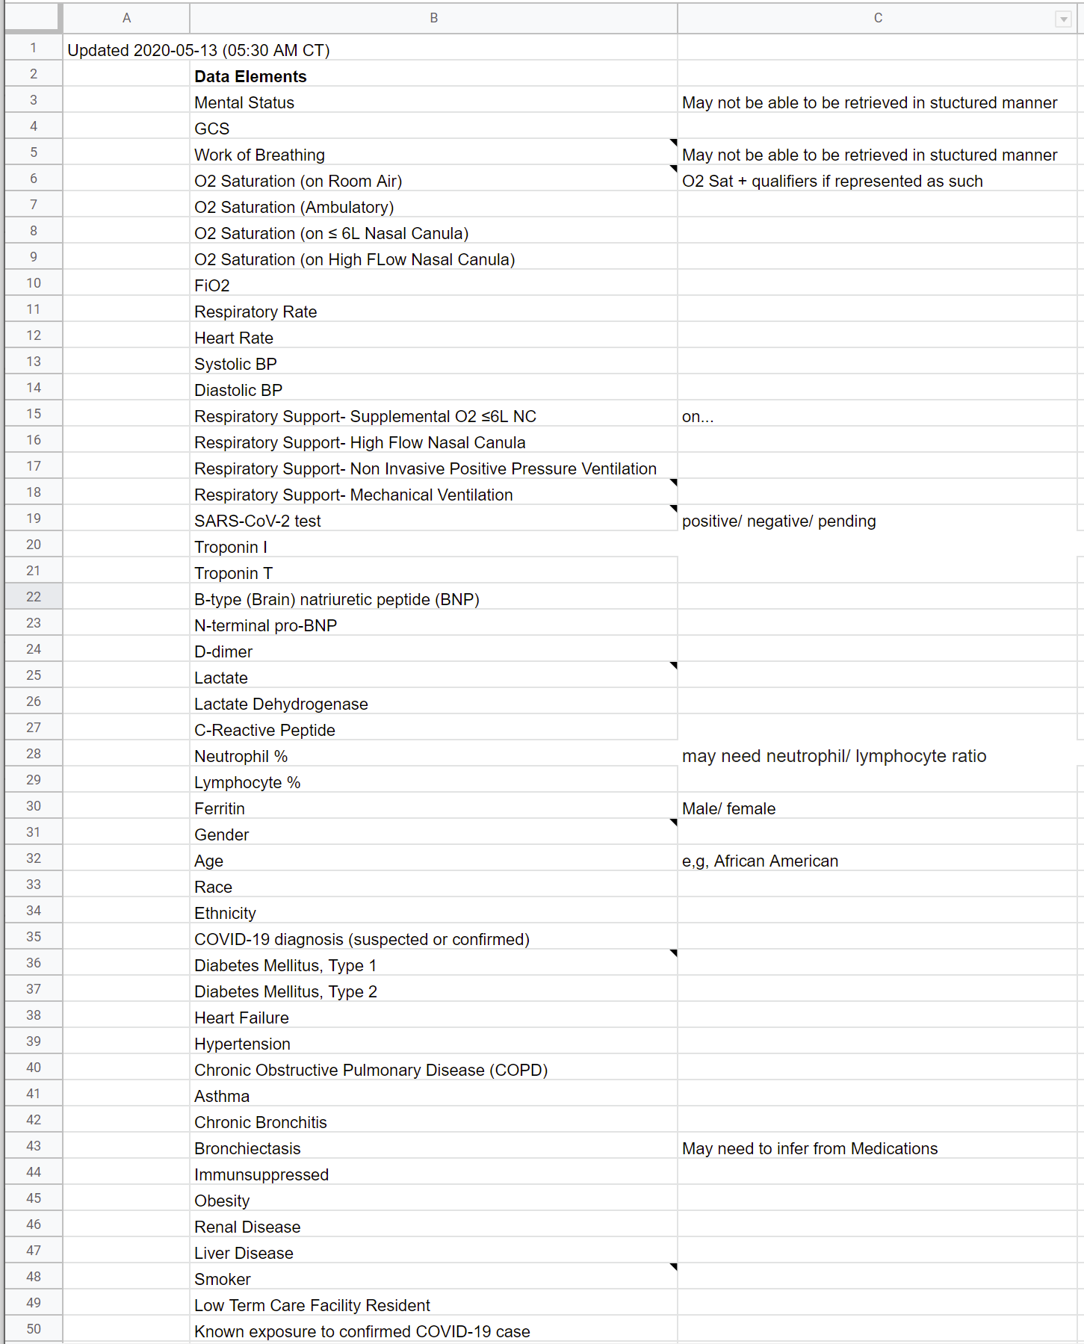
L1 – Narrative
L2 – Semi-Structured
L3 – Structured
L4 – Executable
T3 – Forms
Case Examples
Paper Forms
User Stories
Personas
User-interface Forms
Visualizations
Interaction Model
Wire Frames
Flow Diagrams
Questionnaire (SDC)
Workflows
Decision Trees, Tables, and Flows
Triggers
Concept Maps
Library (CQL)
ActivityDefinition
PlanDefinition
Inferred CaseFeatures
Application Services
Health Record Systems
Decision Services
Guideline narrative
Evidence Summaries
Tables & Figures
T2 – Logic
Glossaries
Domain Concepts
Indicator descriptions
Terminologies
Data Dictionary
Indicators
CodeSystem
ValueSet
StructureDefinition
Data Requirements
Systems of Record
Registries and Exchanges
Data Services
T1 – Data
Notes:
L1 – Narrative content, so paper forms, guidelines, dictionaries, and other supportive documentation
L2 – Semi-structured, so personas, use cases, flow diagrams, decision trees, data dictionaries, and indicator descriptions
L3 – Structured, so Questionnaire, Library, ActivityDefinition, PlanDefinition, terminology resources, CQL logic, Measure
L4 – Running systems

Slide 24
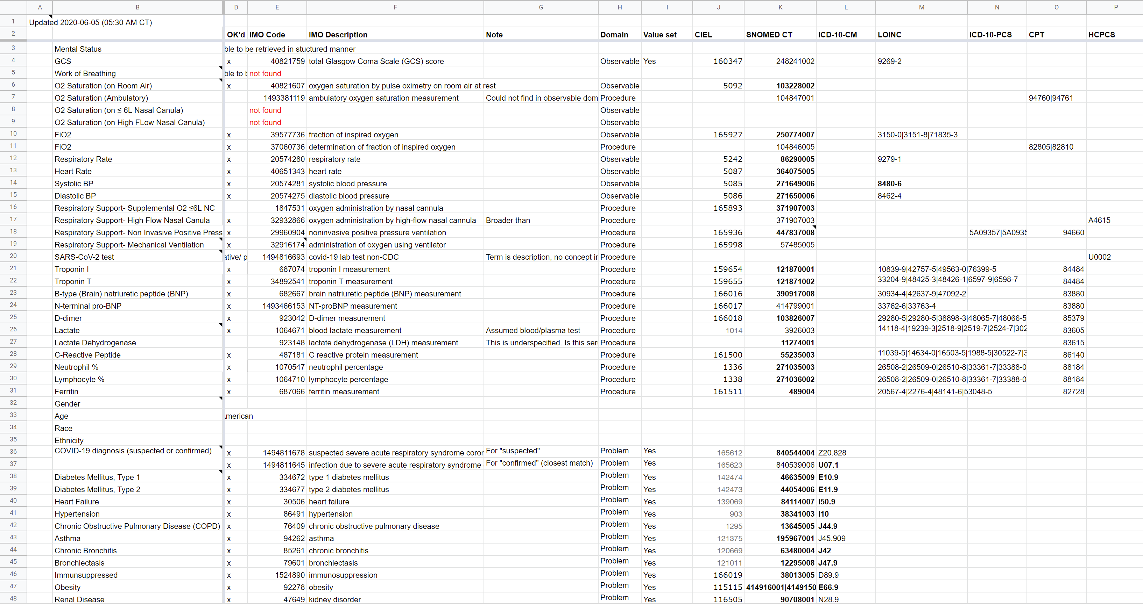
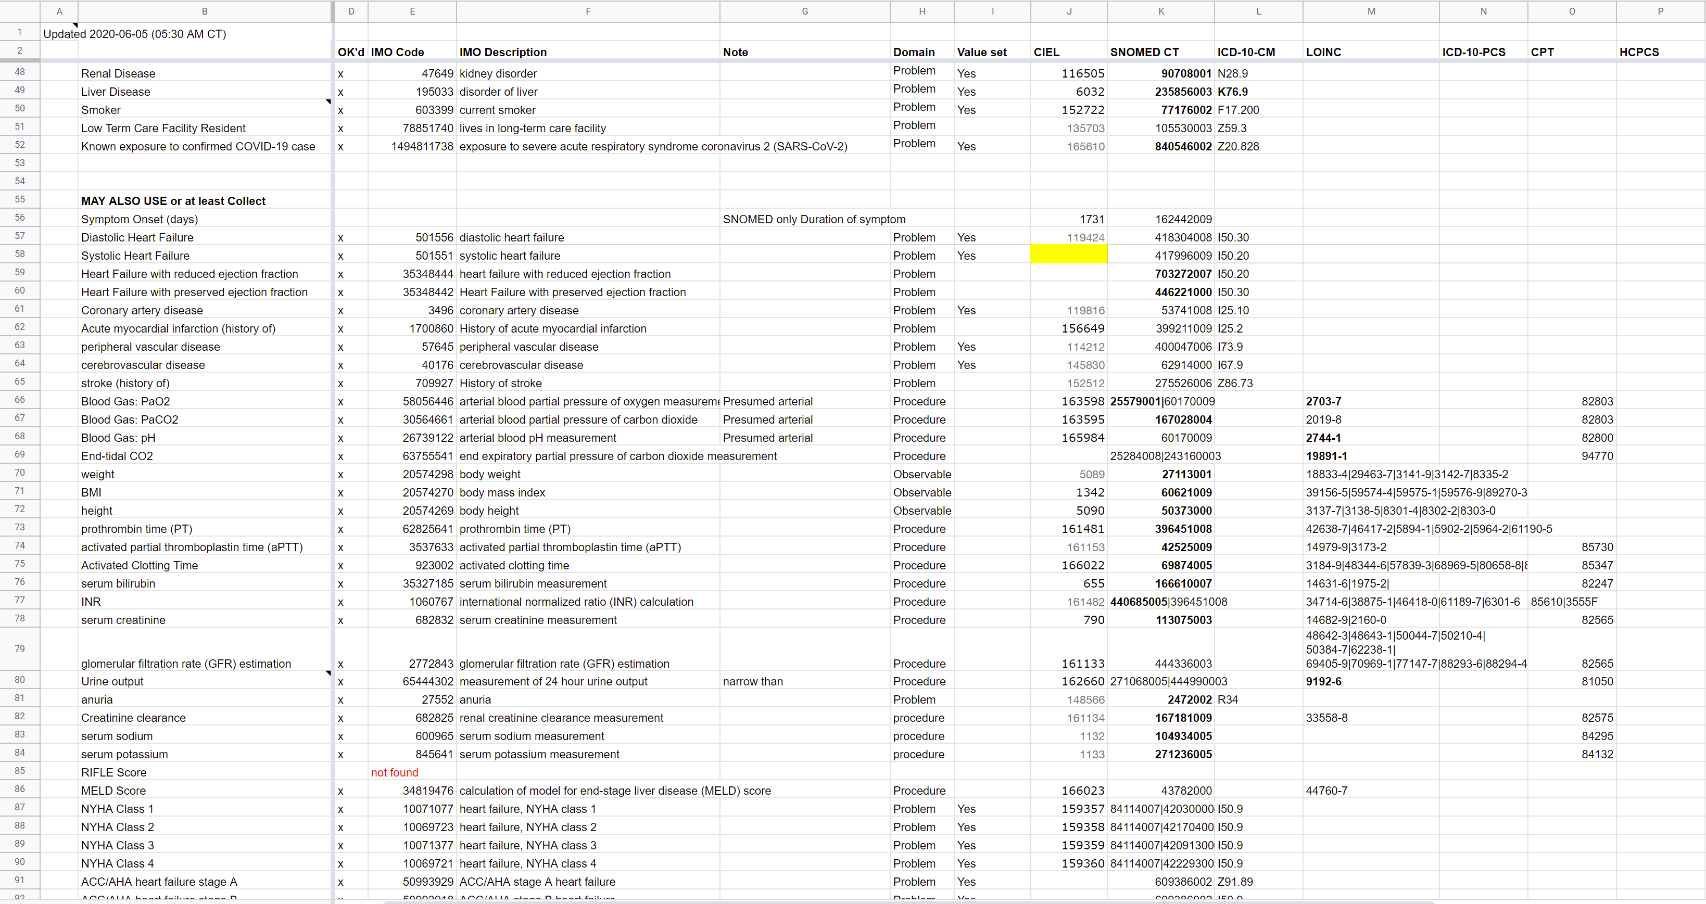
L1 – Narrative
L2 – Semi-Structured
L3 – Structured
L4 – Executable
T3 – Forms
Case Examples
Paper Forms
User Stories
Personas
User-interface Forms
Visualizations
Interaction Model
Wire Frames
Flow Diagrams
Questionnaire (SDC)
Workflows
Decision Trees, Tables, and Flows
Triggers
Concept Maps
Library (CQL)
ActivityDefinition
PlanDefinition
Inferred CaseFeatures
Application Services
Health Record Systems
Decision Services
Guideline narrative
Evidence Summaries
Tables & Figures
T2 – Logic
Glossaries
Domain Concepts
Indicator descriptions
Terminologies
Data Dictionary
Indicators
CodeSystem
ValueSet
StructureDefinition
Data Requirements
Systems of Record
Registries and Exchanges
Data Services
T1 – Data
Notes:
L1 – Narrative content, so paper forms, guidelines, dictionaries, and other supportive documentation
L2 – Semi-structured, so personas, use cases, flow diagrams, decision trees, data dictionaries, and indicator descriptions
L3 – Structured, so Questionnaire, Library, ActivityDefinition, PlanDefinition, terminology resources, CQL logic, Measure
L4 – Running systems

Slide 25
L1 – Narrative
L2 – Semi-Structured
L3 – Structured
L4 – Executable
T3 – Forms
Case Examples
Paper Forms
User Stories
Personas
User-interface Forms
Visualizations
Interaction Model
Wire Frames
Flow Diagrams
Questionnaire (SDC)
Workflows
Decision Trees, Tables, and Flows
Triggers
Concept Maps
Library (CQL)
ActivityDefinition
PlanDefinition
Inferred CaseFeatures
Application Services
Health Record Systems
Decision Services
Guideline narrative
Evidence Summaries
Tables & Figures
T2 – Logic
Glossaries
Domain Concepts
Indicator descriptions
Terminologies
Data Dictionary
Indicators
CodeSystem
ValueSet
StructureDefinition
Data Requirements
Systems of Record
Registries and Exchanges
Data Services
T1 – Data
Notes:
L1 – Narrative content, so paper forms, guidelines, dictionaries, and other supportive documentation
L2 – Semi-structured, so personas, use cases, flow diagrams, decision trees, data dictionaries, and indicator descriptions
L3 – Structured, so Questionnaire, Library, ActivityDefinition, PlanDefinition, terminology resources, CQL logic, Measure
L4 – Running systems

Slide 26
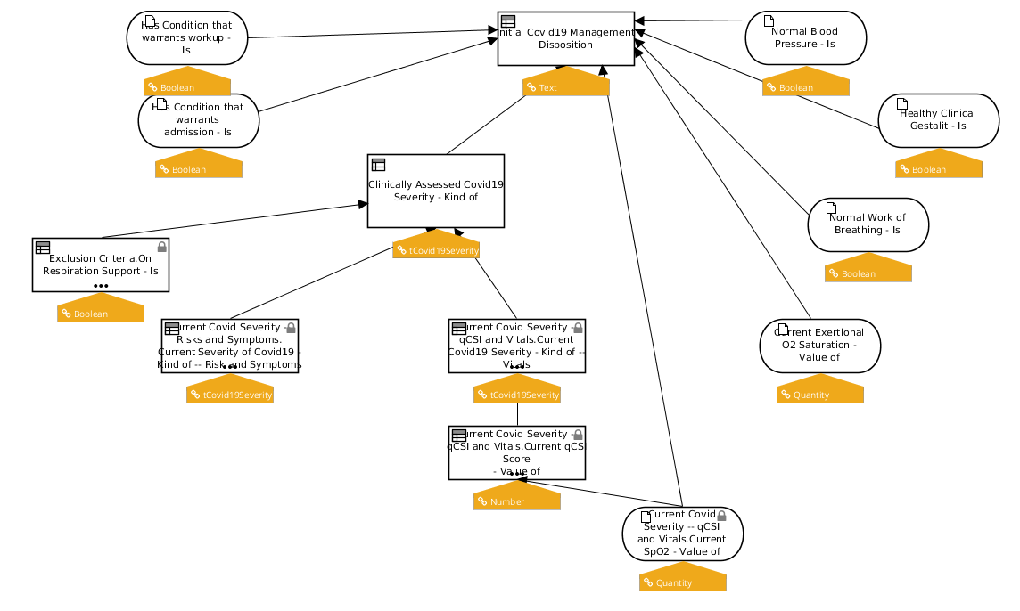
L1 – Narrative
L2 – Semi-Structured
L3 – Structured
L4 – Executable
T3 – Forms
Case Examples
Paper Forms
User Stories
Personas
User-interface Forms
Visualizations
Interaction Model
Wire Frames
Flow Diagrams
Questionnaire (SDC)
Workflows
Decision Trees, Tables, and Flows
Triggers
Concept Maps
Library (CQL)
ActivityDefinition
PlanDefinition
Inferred CaseFeatures
Application Services
Health Record Systems
Decision Services
Guideline narrative
Evidence Summaries
Tables & Figures
T2 – Logic
Glossaries
Domain Concepts
Indicator descriptions
Terminologies
Data Dictionary
Indicators
CodeSystem
ValueSet
StructureDefinition
Data Requirements
Systems of Record
Registries and Exchanges
Data Services
T1 – Data
Notes:
L1 – Narrative content, so paper forms, guidelines, dictionaries, and other supportive documentation
L2 – Semi-structured, so personas, use cases, flow diagrams, decision trees, data dictionaries, and indicator descriptions
L3 – Structured, so Questionnaire, Library, ActivityDefinition, PlanDefinition, terminology resources, CQL logic, Measure
L4 – Running systems

Slide 27
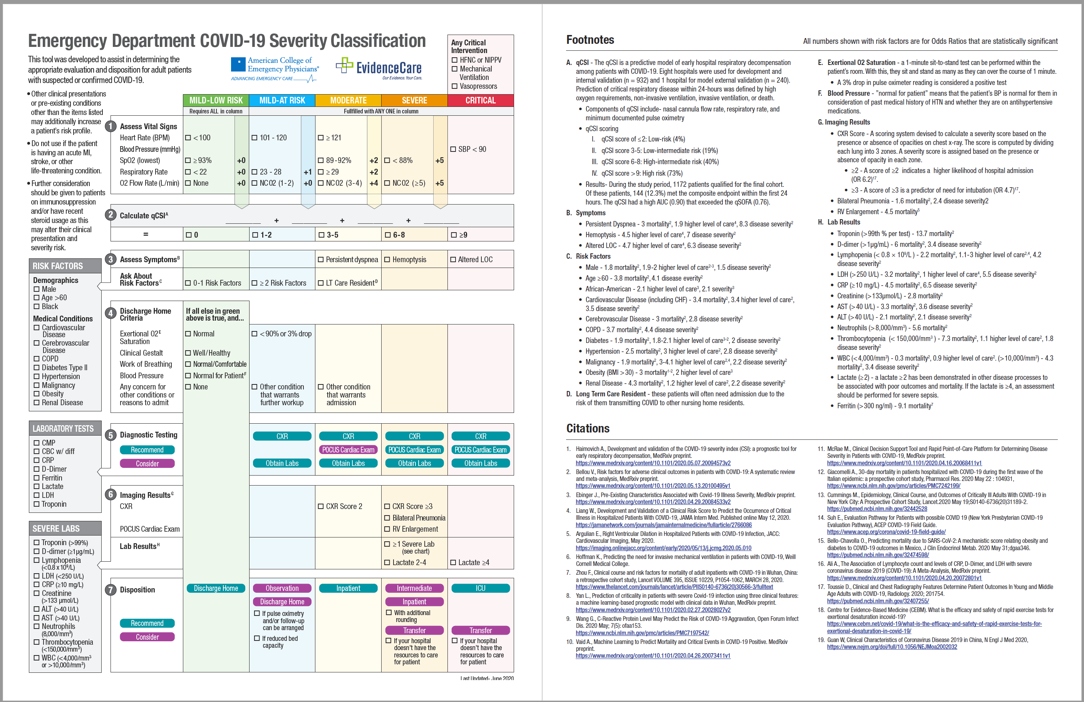
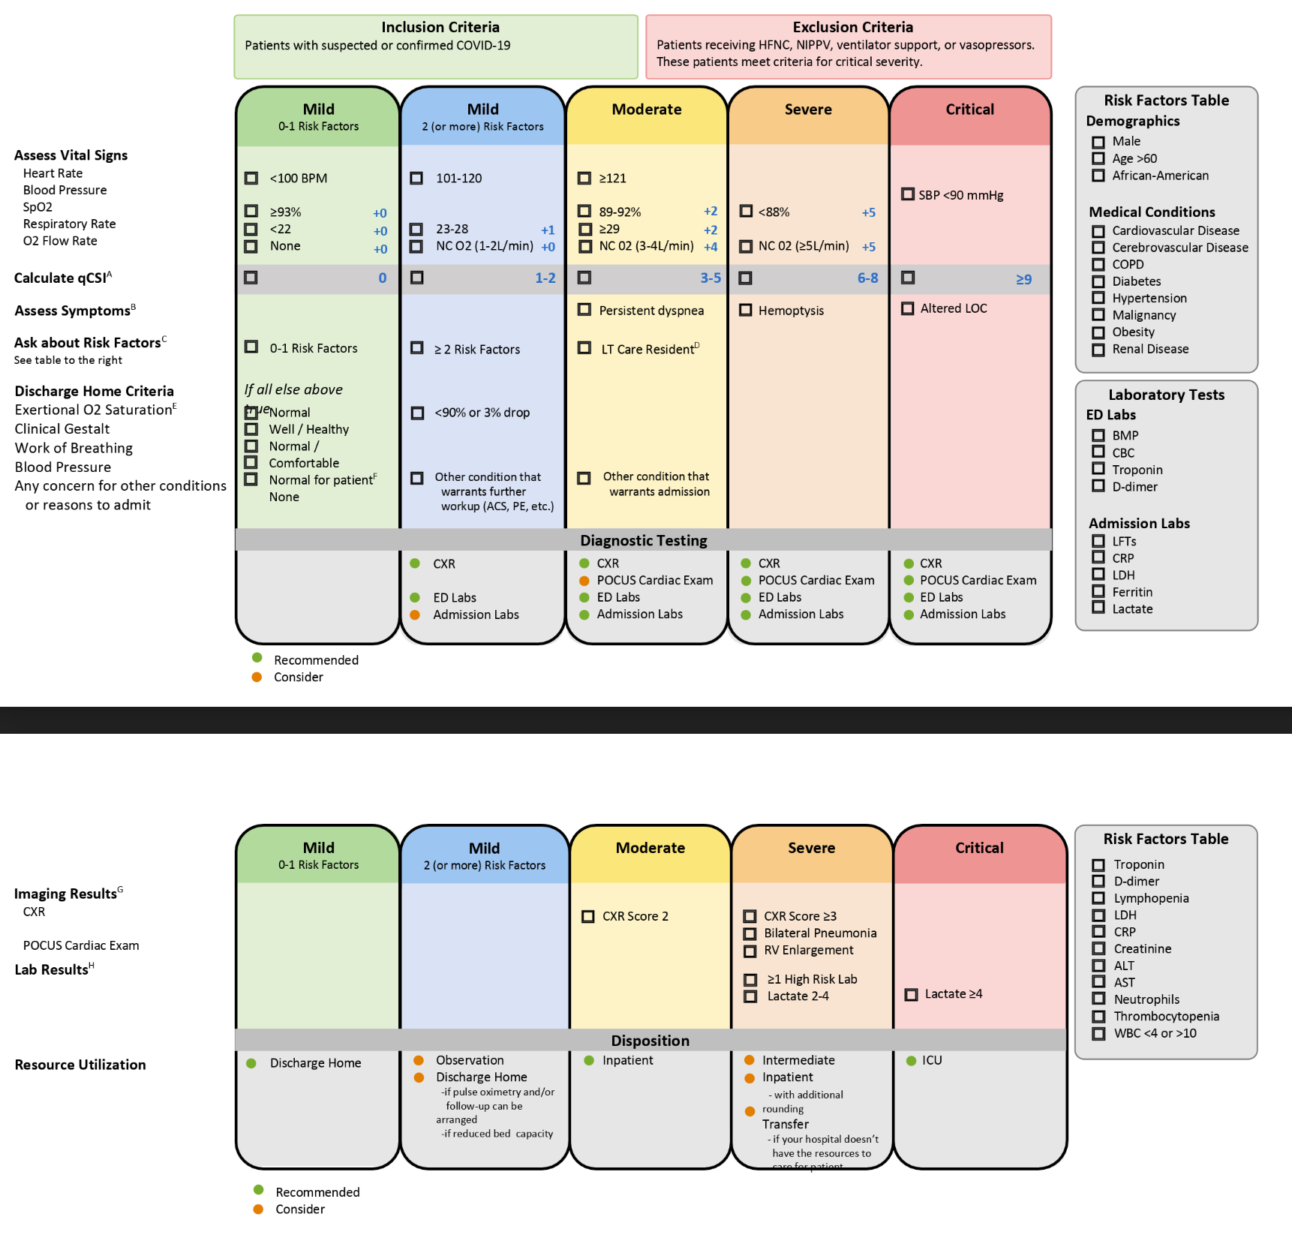
L1 – Narrative
L2 – Semi-Structured
L3 – Structured
L4 – Executable
T3 – Forms
Case Examples
Paper Forms
User Stories
Personas
User-interface Forms
Visualizations
Interaction Model
Wire Frames
Flow Diagrams
Questionnaire (SDC)
Workflows
Decision Trees, Tables, and Flows
Triggers
Concept Maps
Library (CQL)
ActivityDefinition
PlanDefinition
Inferred CaseFeatures
Application Services
Health Record Systems
Decision Services
Guideline narrative
Evidence Summaries
Tables & Figures
T2 – Logic
Glossaries
Domain Concepts
Indicator descriptions
Terminologies
Data Dictionary
Indicators
CodeSystem
ValueSet
StructureDefinition
Data Requirements
Systems of Record
Registries and Exchanges
Data Services
T1 – Data
Notes:
L1 – Narrative content, so paper forms, guidelines, dictionaries, and other supportive documentation
L2 – Semi-structured, so personas, use cases, flow diagrams, decision trees, data dictionaries, and indicator descriptions
L3 – Structured, so Questionnaire, Library, ActivityDefinition, PlanDefinition, terminology resources, CQL logic, Measure
L4 – Running systems

Slide 28
L1 – Narrative
L2 – Semi-Structured
L3 – Structured
L4 – Executable
T3 – Forms
Case Examples
Paper Forms
User Stories
Personas
User-interface Forms
Visualizations
Interaction Model
Wire Frames
Flow Diagrams
Questionnaire (SDC)
Workflows
Decision Trees, Tables, and Flows
Triggers
Concept Maps
Library (CQL)
ActivityDefinition
PlanDefinition
Inferred CaseFeatures
Application Services
Health Record Systems
Decision Services
Guideline narrative
Evidence Summaries
Tables & Figures
T2 – Logic
Glossaries
Domain Concepts
Indicator descriptions
Terminologies
Data Dictionary
Indicators
CodeSystem
ValueSet
StructureDefinition
Data Requirements
Systems of Record
Registries and Exchanges
Data Services
T1 – Data
Notes:
L1 – Narrative content, so paper forms, guidelines, dictionaries, and other supportive documentation
L2 – Semi-structured, so personas, use cases, flow diagrams, decision trees, data dictionaries, and indicator descriptions
L3 – Structured, so Questionnaire, Library, ActivityDefinition, PlanDefinition, terminology resources, CQL logic, Measure
L4 – Running systems

Slide 29


L1 – Narrative
L2 – Semi-Structured
L3 – Structured
L4 – Executable
T3 – Forms
Case Examples
Paper Forms
User Stories
Personas
User-interface Forms
Visualizations
Interaction Model
Wire Frames
Flow Diagrams
Questionnaire (SDC)
Workflows
Decision Trees, Tables, and Flows
Triggers
Concept Maps
Library (CQL)
ActivityDefinition
PlanDefinition
Inferred CaseFeatures
Application Services
Health Record Systems
Decision Services
Guideline narrative
Evidence Summaries
Tables & Figures
T2 – Logic
Glossaries
Domain Concepts
Indicator descriptions
Terminologies
Data Dictionary
Indicators
CodeSystem
ValueSet
StructureDefinition
Data Requirements
Systems of Record
Registries and Exchanges
Data Services
T1 – Data
Notes:
L1 – Narrative content, so paper forms, guidelines, dictionaries, and other supportive documentation
L2 – Semi-structured, so personas, use cases, flow diagrams, decision trees, data dictionaries, and indicator descriptions
L3 – Structured, so Questionnaire, Library, ActivityDefinition, PlanDefinition, terminology resources, CQL logic, Measure
L4 – Running systems

Slide 30

L1 – Narrative
L2 – Semi-Structured
L3 – Structured
L4 – Executable
T3 – Forms
Case Examples
Paper Forms
User Stories
Personas
User-interface Forms
Visualizations
Interaction Model
Wire Frames
Flow Diagrams
Questionnaire (SDC)
Workflows
Decision Trees, Tables, and Flows
Triggers
Concept Maps
Library (CQL)
ActivityDefinition
PlanDefinition
Inferred CaseFeatures
Application Services
Health Record Systems
Decision Services
Guideline narrative
Evidence Summaries
Tables & Figures
T2 – Logic
Glossaries
Domain Concepts
Indicator descriptions
Terminologies
Data Dictionary
Indicators
CodeSystem
ValueSet
StructureDefinition
Data Requirements
Systems of Record
Registries and Exchanges
Data Services
T1 – Data
Notes:
L1 – Narrative content, so paper forms, guidelines, dictionaries, and other supportive documentation
L2 – Semi-structured, so personas, use cases, flow diagrams, decision trees, data dictionaries, and indicator descriptions
L3 – Structured, so Questionnaire, Library, ActivityDefinition, PlanDefinition, terminology resources, CQL logic, Measure
L4 – Running systems

Slide 31
L1 – Narrative
L2 – Semi-Structured
L3 – Structured
L4 – Executable
T3 – Forms
Case Examples
Paper Forms
User Stories
Personas
User-interface Forms
Visualizations
Interaction Model
Wire Frames
Flow Diagrams
Questionnaire (SDC)
Workflows
Decision Trees, Tables, and Flows
Triggers
Concept Maps
Library (CQL)
ActivityDefinition
PlanDefinition
Inferred CaseFeatures
Application Services
Health Record Systems
Decision Services
Guideline narrative
Evidence Summaries
Tables & Figures
T2 – Logic
Glossaries
Domain Concepts
Indicator descriptions
Terminologies
Data Dictionary
Indicators
CodeSystem
ValueSet
StructureDefinition
Data Requirements
Systems of Record
Registries and Exchanges
Data Services
T1 – Data
Notes:
L1 – Narrative content, so paper forms, guidelines, dictionaries, and other supportive documentation
L2 – Semi-structured, so personas, use cases, flow diagrams, decision trees, data dictionaries, and indicator descriptions
L3 – Structured, so Questionnaire, Library, ActivityDefinition, PlanDefinition, terminology resources, CQL logic, Measure
L4 – Running systems

Slide 32
L1 – Narrative
L2 – Semi-Structured
L3 – Structured
L4 – Executable
T3 – Forms
Case Examples
Paper Forms
User Stories
Personas
User-interface Forms
Visualizations
Interaction Model
Wire Frames
Flow Diagrams
Questionnaire (SDC)
Workflows
Decision Trees, Tables, and Flows
Triggers
Concept Maps
Library (CQL)
ActivityDefinition
PlanDefinition
Inferred CaseFeatures
Application Services
Health Record Systems
Decision Services
Guideline narrative
Evidence Summaries
Tables & Figures
T2 – Logic
Glossaries
Domain Concepts
Indicator descriptions
Terminologies
Data Dictionary
Indicators
CodeSystem
ValueSet
StructureDefinition
Data Requirements
Systems of Record
Registries and Exchanges
Data Services
T1 – Data
Notes:
L1 – Narrative content, so paper forms, guidelines, dictionaries, and other supportive documentation
L2 – Semi-structured, so personas, use cases, flow diagrams, decision trees, data dictionaries, and indicator descriptions
L3 – Structured, so Questionnaire, Library, ActivityDefinition, PlanDefinition, terminology resources, CQL logic, Measure
L4 – Running systems

Slide 33


L1 – Narrative
L2 – Semi-Structured
L3 – Structured
L4 – Executable
T3 – Forms
Case Examples
Paper Forms
User Stories
Personas
User-interface Forms
Visualizations
Interaction Model
Wire Frames
Flow Diagrams
Questionnaire (SDC)
Workflows
Decision Trees, Tables, and Flows
Triggers
Concept Maps
Library (CQL)
ActivityDefinition
PlanDefinition
Inferred CaseFeatures
Application Services
Health Record Systems
Decision Services
Guideline narrative
Evidence Summaries
Tables & Figures
T2 – Logic
Glossaries
Domain Concepts
Indicator descriptions
Terminologies
Data Dictionary
Indicators
CodeSystem
ValueSet
StructureDefinition
Data Requirements
Systems of Record
Registries and Exchanges
Data Services
T1 – Data
Notes:
L1 – Narrative content, so paper forms, guidelines, dictionaries, and other supportive documentation
L2 – Semi-structured, so personas, use cases, flow diagrams, decision trees, data dictionaries, and indicator descriptions
L3 – Structured, so Questionnaire, Library, ActivityDefinition, PlanDefinition, terminology resources, CQL logic, Measure
L4 – Running systems

Slide 34

L1 – Narrative
L2 – Semi-Structured
L3 – Structured
L4 – Executable
T3 – Forms
Case Examples
Paper Forms
User Stories
Personas
User-interface Forms
Visualizations
Interaction Model
Wire Frames
Flow Diagrams
Questionnaire (SDC)
Workflows
Decision Trees, Tables, and Flows
Triggers
Concept Maps
Library (CQL)
ActivityDefinition
PlanDefinition
Inferred CaseFeatures
Application Services
Health Record Systems
Decision Services
Guideline narrative
Evidence Summaries
Tables & Figures
T2 – Logic
Glossaries
Domain Concepts
Indicator descriptions
Terminologies
Data Dictionary
Indicators
CodeSystem
ValueSet
StructureDefinition
Data Requirements
Systems of Record
Registries and Exchanges
Data Services
T1 – Data
Notes:
L1 – Narrative content, so paper forms, guidelines, dictionaries, and other supportive documentation
L2 – Semi-structured, so personas, use cases, flow diagrams, decision trees, data dictionaries, and indicator descriptions
L3 – Structured, so Questionnaire, Library, ActivityDefinition, PlanDefinition, terminology resources, CQL logic, Measure
L4 – Running systems

Slide 35



Slide 36
L1 – Narrative
L2 – Semi-Structured
L3 – Structured
L4 – Executable
T3 – Forms
Case Examples
Paper Forms
User Stories
Personas
User-interface Forms
Visualizations
Interaction Model
Wire Frames
Flow Diagrams
Questionnaire (SDC)
Workflows
Decision Trees, Tables, and Flows
Triggers
Concept Maps
Library (CQL)
ActivityDefinition
PlanDefinition
Inferred CaseFeatures
Application Services
Health Record Systems
Decision Services
Guideline narrative
Evidence Summaries
Tables & Figures
T2 – Logic
Glossaries
Domain Concepts
Indicator descriptions
Terminologies
Data Dictionary
Indicators
CodeSystem
ValueSet
StructureDefinition
Data Requirements
Systems of Record
Registries and Exchanges
Data Services
T1 – Data
Notes:
L1 – Narrative content, so paper forms, guidelines, dictionaries, and other supportive documentation
L2 – Semi-structured, so personas, use cases, flow diagrams, decision trees, data dictionaries, and indicator descriptions
L3 – Structured, so Questionnaire, Library, ActivityDefinition, PlanDefinition, terminology resources, CQL logic, Measure
L4 – Running systems

Slide 37


L1 – Narrative
L2 – Semi-Structured
L3 – Structured
L4 – Executable
T3 – Forms
Case Examples
Paper Forms
User Stories
Personas
User-interface Forms
Visualizations
Interaction Model
Wire Frames
Flow Diagrams
Questionnaire (SDC)
Workflows
Decision Trees, Tables, and Flows
Triggers
Concept Maps
Library (CQL)
ActivityDefinition
PlanDefinition
Inferred CaseFeatures
Application Services
Health Record Systems
Decision Services
Guideline narrative
Evidence Summaries
Tables & Figures
T2 – Logic
Glossaries
Domain Concepts
Indicator descriptions
Terminologies
Data Dictionary
Indicators
CodeSystem
ValueSet
StructureDefinition
Data Requirements
Systems of Record
Registries and Exchanges
Data Services
T1 – Data
Notes:
L1 – Narrative content, so paper forms, guidelines, dictionaries, and other supportive documentation
L2 – Semi-structured, so personas, use cases, flow diagrams, decision trees, data dictionaries, and indicator descriptions
L3 – Structured, so Questionnaire, Library, ActivityDefinition, PlanDefinition, terminology resources, CQL logic, Measure
L4 – Running systems

Slide 38


L1 – Narrative
L2 – Semi-Structured
L3 – Structured
L4 – Executable
T3 – Forms
Case Examples
Paper Forms
User Stories
Personas
User-interface Forms
Visualizations
Interaction Model
Wire Frames
Flow Diagrams
Questionnaire (SDC)
Workflows
Decision Trees, Tables, and Flows
Triggers
Concept Maps
Library (CQL)
ActivityDefinition
PlanDefinition
Inferred CaseFeatures
Application Services
Health Record Systems
Decision Services
Guideline narrative
Evidence Summaries
Tables & Figures
T2 – Logic
Glossaries
Domain Concepts
Indicator descriptions
Terminologies
Data Dictionary
Indicators
CodeSystem
ValueSet
StructureDefinition
Data Requirements
Systems of Record
Registries and Exchanges
Data Services
T1 – Data
Notes:
L1 – Narrative content, so paper forms, guidelines, dictionaries, and other supportive documentation
L2 – Semi-structured, so personas, use cases, flow diagrams, decision trees, data dictionaries, and indicator descriptions
L3 – Structured, so Questionnaire, Library, ActivityDefinition, PlanDefinition, terminology resources, CQL logic, Measure
L4 – Running systems

Slide 39


L1 – Narrative
L2 – Semi-Structured
L3 – Structured
L4 – Executable
T3 – Forms
Case Examples
Paper Forms
User Stories
Personas
User-interface Forms
Visualizations
Interaction Model
Wire Frames
Flow Diagrams
Questionnaire (SDC)
Workflows
Decision Trees, Tables, and Flows
Triggers
Concept Maps
Library (CQL)
ActivityDefinition
PlanDefinition
Inferred CaseFeatures
Application Services
Health Record Systems
Decision Services
Guideline narrative
Evidence Summaries
Tables & Figures
T2 – Logic
Glossaries
Domain Concepts
Indicator descriptions
Terminologies
Data Dictionary
Indicators
CodeSystem
ValueSet
StructureDefinition
Data Requirements
Systems of Record
Registries and Exchanges
Data Services
T1 – Data
Notes:
L1 – Narrative content, so paper forms, guidelines, dictionaries, and other supportive documentation
L2 – Semi-structured, so personas, use cases, flow diagrams, decision trees, data dictionaries, and indicator descriptions
L3 – Structured, so Questionnaire, Library, ActivityDefinition, PlanDefinition, terminology resources, CQL logic, Measure
L4 – Running systems

Slide 40

L1 – Narrative
L2 – Semi-Structured
L3 – Structured
L4 – Executable
T3 – Forms
Case Examples
Paper Forms
User Stories
Personas
User-interface Forms
Visualizations
Interaction Model
Wire Frames
Flow Diagrams
Questionnaire (SDC)
Workflows
Decision Trees, Tables, and Flows
Triggers
Concept Maps
Library (CQL)
ActivityDefinition
PlanDefinition
Inferred CaseFeatures
Application Services
Health Record Systems
Decision Services
Guideline narrative
Evidence Summaries
Tables & Figures
T2 – Logic
Glossaries
Domain Concepts
Indicator descriptions
Terminologies
Data Dictionary
Indicators
CodeSystem
ValueSet
StructureDefinition
Data Requirements
Systems of Record
Registries and Exchanges
Data Services
T1 – Data
Notes:
L1 – Narrative content, so paper forms, guidelines, dictionaries, and other supportive documentation
L2 – Semi-structured, so personas, use cases, flow diagrams, decision trees, data dictionaries, and indicator descriptions
L3 – Structured, so Questionnaire, Library, ActivityDefinition, PlanDefinition, terminology resources, CQL logic, Measure
L4 – Running systems

Slide 41
L1 – Narrative
L2 – Semi-Structured
L3 – Structured
L4 – Executable
T3 – Forms
Case Examples
Paper Forms
User Stories
Personas
User-interface Forms
Visualizations
Interaction Model
Wire Frames
Flow Diagrams
Questionnaire (SDC)
Workflows
Decision Trees, Tables, and Flows
Triggers
Concept Maps
Library (CQL)
ActivityDefinition
PlanDefinition
Inferred CaseFeatures
Application Services
Health Record Systems
Decision Services
Guideline narrative
Evidence Summaries
Tables & Figures
T2 – Logic
Glossaries
Domain Concepts
Indicator descriptions
Terminologies
Data Dictionary
Indicators
CodeSystem
ValueSet
StructureDefinition
Data Requirements
Systems of Record
Registries and Exchanges
Data Services
T1 – Data
Notes:
L1 – Narrative content, so paper forms, guidelines, dictionaries, and other supportive documentation
L2 – Semi-structured, so personas, use cases, flow diagrams, decision trees, data dictionaries, and indicator descriptions
L3 – Structured, so Questionnaire, Library, ActivityDefinition, PlanDefinition, terminology resources, CQL logic, Measure
L4 – Running systems

Slide 42
Use Case 1: COVID-19 Severity Score & ED Disposition
C19 Digital Guideline Working Group

Slide 43
Content Team Needs Identification & Prioritization
Front Line Clinicians Identify Need
Review the Evidence Base +/- Expert Consensus
Work with KE Team to Scope Difficulty & Opportunity
Prioritized based on:
Need/ Impact
Difficulty
Evidence or Consensus to Support Best Practice

Slide 44


Development of Severity Score (Pre-L1)

Slide 45
Initial Description of Severity Score (L1/L2)

Slide 46
Data Elements Identified in
Initial Description of Severity Score
Feedback from Terminology Vendors & Coalition (Interoperability Alliance)

Slide 47


Initial Draft Decision Table (L3-ish)
From Initial Description of Severity Score using BPM+ Model
1 Week

Slide 48



Continued Review of the Evidence Base

Slide 49

Third Iteration of Severity Score (L1/L2)
Initial Sketch of L1 Illustration

Slide 50
Terminologies- Codes, Value Sets (L3)
From Data Elements Identified/ Updated

Slide 51


Fourth Iteration of Severity Score (L1/L2)
v1 L1 Illustration from GDG

Slide 52

L2 Flow Diagram
Based on 3rd/4th Version L1/L2

Slide 53
Semi-Structured Form
L1 -> L2 Following CPG-IG Recommendation Model

Slide 54
Semi-Structured Form
L1 -> L2 Following CPG-IG Recommendation Model

Slide 55
Clarification Between Content & KE
Highly Advanced KE Collaboration Tooling (Email)

Slide 56

v2 L1 Severity Score from GDG

Slide 57

Fifth Iteration of Severity Score (L1/L2)
v1 L1 Illustration from GDG

Slide 58
v3 of L1 Severity Score from GDG

Slide 59


2nd Iteration of Decision Table (L3)
From Latest Description of Severity Score using BPM+ Model

Slide 60
#2
Pathway
BPMN
Measure
DMN* (Strategy)
Strategy
#10
L2 Doc
#9
#3
Inference /Strategy
#4
DMN* Inference
#7
#8
Data Elem
Inference /Assessment
Questionnaire
Clinical Ontology
#5
CaseFeature Def
#6
#1
CQL Retrieve
Formalism
Presentation
Execution
Interchange

Slide 61
#1 Clinical Concept Ontology
“Vernaculars” for Pathways
Post-Coordinated SNOMED Classes / Concepts
Bridge Ontology / Terminology / ValueSets

Slide 62

#2 Pathway : Process Aspects

Slide 63


Slide 65


Slide 68

#3: Pathway : Disposition

Slide 69


#4 Pathway - Inference / Enrichment

Slide 70


( Simulation )
Pictorial Languages w/ L3+ execution semantics

Slide 71


#5 Annotated XML w/ OWL references

Slide 72



Ontology / Data Bridge
Clinical Ontologies
C(3)PO placeholder (next slide)

Slide 73



#7 Decision Services / Questionnaires

Slide 74



#8 Decision → Table → Inference

Slide 75



#9 Indications

Slide 76


#11 PlanDefinition / Pathway

Slide 77
#10 - 1 Measure
I
E
D
N

Slide 78



#10 - 2 Measure

Slide 79


#10 - 3 Measure

Slide 83
Appendix 2: AGILE Approach to CPG Development AGILE KE
C19 Digital Guideline Working Group
http://build.fhir.org/ig/HL7/cqf-recommendations/documentation-approach-12-conceptual-knowledge-architecture.html

Slide 84
Integration & Collaboration with Guideline Development Process and CPG Knowledge Engineering Lifecycle Processes

Slide 85
Program
Management
Provide Vision & Strategy, Coordinate Team Efforts, Shared Lessons Learned, Remove Blockers, Nurture Ecosystem Partnerships
Per Prioritized CPG, though some assets will be reused across CPGs
Content
Identify Need & Opportunity
Prioritized CPG Topic Defined & Feasible
Agile CPG Team Formed
CPG L1, L2, L3 Initiated
CPG L1, L2, L3 Iterated
CPG L1, L2, L3 Finalized
Knowledge
Engineering
Common
Process & Tooling
Feasibility Assessment
L1->L2
Draft
L1, L2, L3
High Level v1
L1, L2, L3
‘Chunks’
Iterated
L1, L2, L3
Composites Iterated
L1, L2, L3
Finalized
Terminology
Core
Knowledge Engineering Effort
Common
Process & Tooling
Initial Data Requirements
Defined
Value Sets
Identified
Terminologies
Defined
Code
Mappings
Validation
Core
Delivery
Effort
Common Process, Tooling, & Data
Case
Examples
Test Cases
As Spec
Test Cases
Iterated
Expanded
Testing
Iterated
Expanded
Validation
Completed
Delivery
Core
Implementation
Effort
Common Capabilities, Approach & Tooling
Delivery Implications Identified
Adjust
Delivery
Approach
Test
Delivery
Mechanisms
Finalize
Delivery
Implementation
Engage & Communicate
Need
Share Best
Practices
Identify
Pilot Sites
Obtain RWD
IF Feasible
Planning
Engaging
Initiate
Limited Pilot
Knowledge
Architecture
Develop & Evolve Knowledge Architecture (Asset Definitions), Tooling Specifications,
Work with Standards Orgs, Enable Asset Re-usability and Shareability, Enable Knowledge Content Management

Slide 86
Agile Principles & Best Practices (applied to KE)
Cross functional teams
Frequent, brief team communications (e.g. Scrum)
Domain-driven design (focus on domain and domain logic, integration of domain experts, based on model of domain- as is done in knowledge architecture and knowledge-driven systems)
Iterative and incremental development (e.g. Chunking)
Low-code development platforms (e.g editors and authoring tools for domain experts)
Paired programming (e.g. SME knowledge engineer with technical/formalism knowledge engineer)
Retrospectives (e.g. continuous sharing of lessons learned)
Specification by example (e.g. real “test cases” to aid in defining requirements- including inputs and expected results for at least critical logic paths)
Test-driven development (e.g. start with few critical test cases, use short iterations to create logic, and use it to aid in generating additional test cases than are simply graded to be re-used for ‘build’ vs wholly generated manually)
Test-integration (e.g. testing of all individual and composite knowledge assets/artifacts)

Slide 87
Cross-functional, Integrated Team
Domain SME’s (Content)- Lead
SME Knowledge Engineers (Elicitation/Acquisition & Translation Expertise)
Technical Knowledge Engineers (Formalism expertise)
Knowledge Artifact/ Asset
Expression Language(s)
Terminologies/Ontologies
Validation/ QA Engineer(s)
Delivery Mechanism(s) / Implementation Expertise (Implementor(s))
Workflow Capture & Analysis Expertise (Health Systems/ Industrial Engineers)

Slide 88
Why Cross-functional, Integrated?
Better Communication- less value/ time/ effort Lost in (mis-) Translation
Collaborate on Artifacts versus use them to wholly transfer information (e.g. L2 with Domain SME, SME KE, and Technical KE)
Facilitates Agile- “break-out” of Waterfall progression of large, singular expressions across Levels of Representation (L1-> L2-> L3-> L4)
Can focus on progressing ‘pieces’- even while the ‘whole’ of early Levels (e.g., L1) yet to be complete
Can begin much earlier on more formal, explicit, and computable Levels (L3)
Often start much closer to L2 and work way to L3/4 and L1 concurrently, and for smaller ‘pieces’ of knowledge (e.g. Data Definitions, singular Recommendations, etc.)

Slide 89
Chunking
Individual ‘pieces’ of knowledge are scoped and broken down into various “fit for purpose” chunks of formalizations
Clinical Concepts and Data Elements with Definitions -> Value Sets & Concept Maps
Individual Case feature definitions -> inferred Case Features as ‘enrichments’
Recommendations & Metrics;
‘Pieces’ are then grouped together in a meaningful whole (e.g. composite assets)
Strategies and Pathways
Derived Assets
Chunks can progress independntly through Levels of Representation
Chunking enables iterative and incremental development of k-assets & ‘pieces’ of knowledge that are reusable across numerous composite assets

Slide 90
Chunking
Constrained, yet “contextualized” Parts: These ‘pieces’ of knowledge are constrained by the knowledge architecture and the standards by which they are represented or formalized.
Building by Composition (or restriction): Composition, in knowledge engineering and representation, simply refers to the ability to combine multiple constituent knowledge assets into a whole. Restriction ~ constraints/ filters.
Iteration: in this context, often refers to successive build-test phases not only for the individual, functional ‘pieces’ of knowledge, but also taking excessive passes of build-test phases of the composite assets

Slide 91
Test-Driven Knowledge Engineering
Individual “Test” Cases as Specification (L1 Case Presentation expressed in Data- an L2 Artifact)
Test Data from:
Generated by KE
Synthetic Data (Synthea and/or “Code Gen”)
De-Identified and/or Real-World Data (concurrent development with Implementation)
Build against Test Data, iterate incremental Assets/Expressions AND Test Data between KE and Validation using Grading and Validation Tooling
Ideally have separate Validation Data or use Implementation/ RW Data than used to specify and build

Slide 92
Iteration & Rapid-Cycle Feedback Loops
Affords the ability to “fail early, fail often, and at lower cost” at earlier stages in the development process
Iterate on early artifacts (L1/2) at lower ‘cost’
Combination of “Chunking” work into smaller ‘pieces’ of knowledge (composite asset components) and test-driven development (of formalism/ expression).
Enables rapid-cycle build-test phases to develop reliable expressions and test decks for “Chunks”, Composites, or Both
Successive ‘build’-test phases for aggregates or composite assets/artifacts
Bottom-Up and Top-Down Concurrently: Can iterate on ‘Pieces’ & Composite together- grading/validating the intermediate & end expression results

Slide 93
Re-Use of Shareable Knowledge Artifacts
Knowledge Management
Assets Definitions and Reuse, Metadata, Cloning, Versioning, Dependencies, Adaptable K-Architecture, Provenance, and Inference Linkage
Situates Assets in a formal Knowledge Architecture to enable “Chunking” and Composite Assets
Atomic “Parts” (e.g. Case Features, inferred Case Features)
Reusable Patterns/Templates for Assets (e.g. Diagnosis Inference)
Use of formal Semantics (Ontologies & Terminologies)
Workflow & Decision Support for Knowledge Engineers

Slide 94


Levels of Knowledge x Tiers of Architecture
L1 – Narrative
L2 – Semi-Structured
L3 – Structured
L4 – Executable
Case Examples
Paper Forms
User Stories
Personas
User-interface Forms
Visualizations
Interaction Model
T3 – Forms
Wire Frames
Flow Diagrams
Questionnaire (SDC)
Workflows
Decision Trees, Tables, and Flows
Triggers
Concept Maps
Library (CQL)
ActivityDefinition
PlanDefinition
Inferred CaseFeatures
Application Services
Health Record Systems
Decision Services
Guideline narrative
Evidence Summaries
Tables & Figures
T2 – Logic
Glossaries
Domain Concepts
Indicator descriptions
Terminologies
Data Dictionary
Indicators
CodeSystem
ValueSet
StructureDefinition
Data Requirements
Systems of Record
Registries and Exchanges
Data Services
T1 – Data
Notes:
L1 – Narrative content, so paper forms, guidelines, dictionaries, and other supportive documentation
L2 – Semi-structured, so personas, use cases, flow diagrams, decision trees, data dictionaries, and indicator descriptions
L3 – Structured, so Questionnaire, Library, ActivityDefinition, PlanDefinition, terminology resources, CQL logic, Measure
L4 – Running systems

Slide 95
Levels of Representation Reconceptualized
Framework for Describing Nature of Representation (NOT Process)
Tradition Knowledge Engineering Approach:
Process Steps that mimicked Progression of Levels-
L2 only on Final L1
L3 only on completion of L2
Agile KE:
Concurrent, iterative, integrated, and cross-functional
Different Expertise work on Different Levels concurrently
Knowledge Increments across Levels
Waterfall
GDP, KE, CDS, &
Implementation
L1
L2
L3
L4
L1
- Shared Tooling
- Shared Information
- Incremental
- Concurrent Development
- Iterative, Rapid Feedback
- Test-Driven
- Reuse Content
Agile
Integrated
Cross-functional
CPG-IG Approach
L2
L3
L4

Slide 96
L1
L2
L3
Knowledge Engineering Lifecycle
Acquire
Represent
Improve
Share/ Deliver
Compute/ Validate
Curate
L1
L4
Agile Translation
with Chunking
L2
*translation
*translation
L3
(within and across Tiers and Formalisms)
CPG IG
Use of Real-World Data for Design, Specification, Development, & one-time Validation
(exact path dependent on Methods of Implementation and mechanisms of Delivery)

Slide 97
Knowledge Representation “Levels”- L1
Clinical Focus
Scope (population attributes from PICOTS, as well as interventions, comparators, outcomes, timing, and setting)
Recommendations (at least in part from PICOTS interventions)
Strength of Recommendation and Quality of Evidence
Evidence references (including analysis and evidence summaries)
Evidence Summaries
Tables and FIgures (including drafts thereof)
Who / what is included (inclusions) for each Recommendation or combinations thereof
Who / what is excluded (exclusions) for each Recommendation or combinations thereof
Case Examples (examples of how patient archetypes might traverse the guideline)
Glossaries- of terms with their descriptions and definitions
Indicator descriptions
Policy considerations (e.g., privacy, access, regulations)
For example, one such guideline is the Guideline for Prescribing Opioids for Chronic Pain (2016) published by the Centers for Disease Control and Prevention (CDC)

Slide 98
Knowledge Representation “Levels”- L2
Concepts - What are the formal domain concepts involved
Concept Maps of all the concepts and their relationships as scoped to the guideline
Visualizations of Processes - (Flow) Diagrams depicting the order of actions and decisions involved, often in parallel to the domain concepts or data elements used as well as workflow and/or potential set of workflow interventions to be employed
Flow diagrams of information, decisions, and processes
Decision Trees and Table
Personas - Who are the actors involved
User Stories - Functional descriptions of what happens from the perspective of each persona
Wireframes of potential user interactions
Triggers - When do the processes happen (i.e., what are the entry points for the processes)
Terminologies and Data Dictionaries
Formal definitions for Indicators (e.g., using pseudocode)
The examples included in this implementation guide illustrate some of the types of content and approaches that can be used for L2

Slide 99
Knowledge Representation “Levels”- L3
Complete value sets specified using standard terminologies (coded concepts, code systems, and intentional and extensional value sets)
Data Requirements
Data element definitions describing the information involved
Including inferred data elements
Computable logic describing, at minimum, the inclusion/exclusion criteria
Resource definitions with respective terminologies including for the recommended activity itself (e.g. MedicationRequest + Value Set for a recommended medication)
Structured recommendations with decision logic (in the form of event-condition-action (ECA) rules)
Structured process definitions describing how the recommendations fit into a clinical workflow (inclusive of decision and orchestration logic such as in CPGStrategies)
Structured form definitions providing a conceptual description of the user-interactions involved (e.g. Adaptive Forms)
All the CPG definitional resources (e.g. CPGPathway, CPGStrategies, CPGRecommendations, CPGCaseFeatures, etc.) are Level 3 representations

Slide 100
Knowledge Representation “Levels”- L4
Mapping of terms (value sets) to local terms
Workflow execution & adjustment of workflow for site-specific factors
Interpretation of computable content in the site-specific environment (see Methods of Implementation)
SMART-on-FHIR App
Native EHR Build at site
CDSHooks Service (in operation)
Quality Measure Engine
eCaseReporting application

Slide 101


Slide 102
Knowledge Representation “Levels”
Knowledge Level | Description | Example
L1 | Narrative | Guideline for a specific disease that is written in the format of a peer-reviewed journal article
L2 | Semi-structured | Formal flow diagrams, decision trees, or other similar formats that describes recommendations for implementation
L3 | Structured | Standards-compliant specification encoding logic with data model(s), terminology/code sets, value sets that is ready to be implemented
L4 | Executable | CDS implemented and used in a local execution environment (e.g., CDS that is live in an electronic health record (EHR) production system) or available via web services
**Note the Levels do not describe a process or required flow, though processes, methods, and tools do often support translation between Levels. Also, the levels of knowledge representation are a continuum, with discrete categories introduced in the methodology to help inform discussions and communicate the concepts involved. L1 targets Domain SME’s, L4 is run-time software, L2 should be readable by humans- Domain SME’s and Technical Knowledge Engineers who must use the L2 to construct faithful computable expressions (L3). L2/L3 *may* also exist as part of an Editor.

